Slide 1
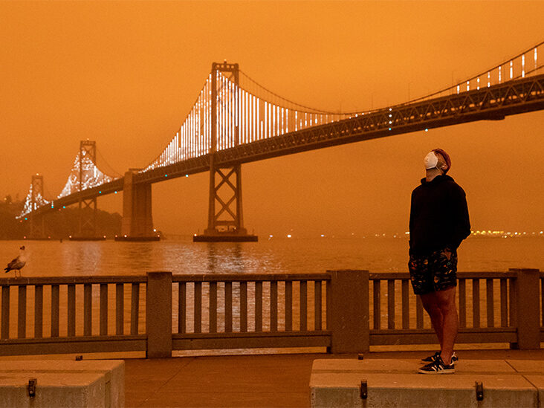
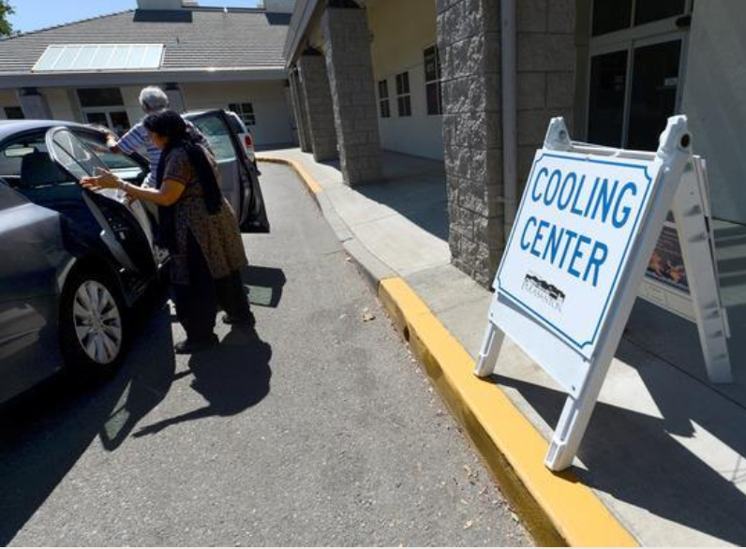
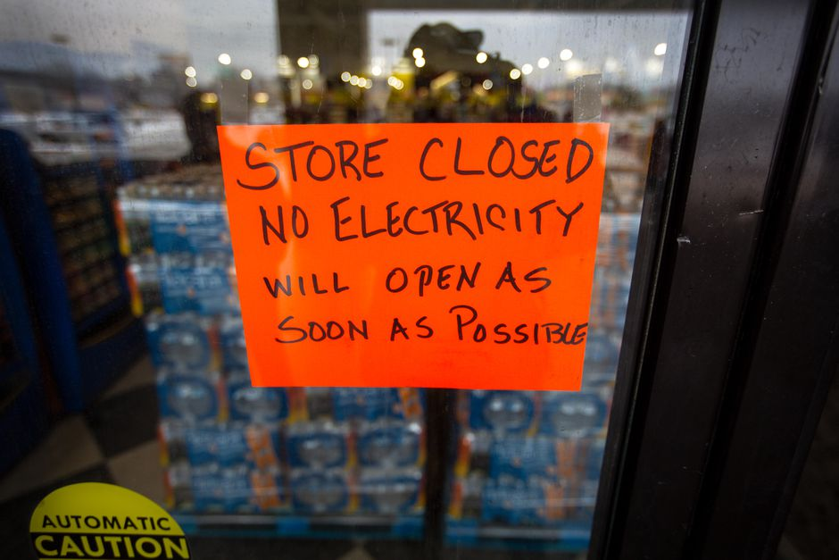
Wildfire & Heat Season Training
Bay bridge in the background of a man with a mask on and orange skies
Sign outside of a building announcing “cooling center”
Sign on the door that reads “store closed, no electricity, will open as soon as possible”
Based on materials developed by City of San Leandro Sustainability, Alameda County Office of Sustainability and Alameda County Health Emergency Preparedness and Response
v.8.2024
Notes:
Hi, this is {Name and Title, organization you are representing}
We are in the midst of heat and fire season in the Bay Area, so we are here to provide some guidance to help you prepare and respond to related threats.
This workshop is designed specifically for organizations or programs who might share this information with others in your community, to prepare for heat waves, wildfire smoke, power shutoffs and more.
This workshop is based on materials developed by City of San Leandro Sustainability, Alameda County Office of Sustainability and Alameda County Health Emergency Preparedness and Response. When sharing or presenting materials, please provide credit, and modify with care.

Slide 2
About us
Notes:
A little bit about us and why we’re providing this training today:
[Provide background information about who is leading the training, the various offices]
{add information about your city or program here, and how participants might access slides or additional information after the presentation}

Slide 3
What you will learn today
Climate disaster preparedness resources and communication tools
Which community members are particularly vulnerable and how to prepare
Preparing for major seasonal hazards
  Wildfire, smoke, and poor air quality
  Power shutoffs
  Extreme heat
Notes:
Today we will cover climate disasters preparedness resources and communication tools, including information about which community members are particularly vulnerable and how to prepare
Then we will dive deep into wildfire smoke, power outages and heat waves, and
Although we do not have a section thoroughly covering earthquakes, the preparedness tips we will cover are applicable to any hazard, including earthquakes.
Finally we will share resources you can use.

Slide 4
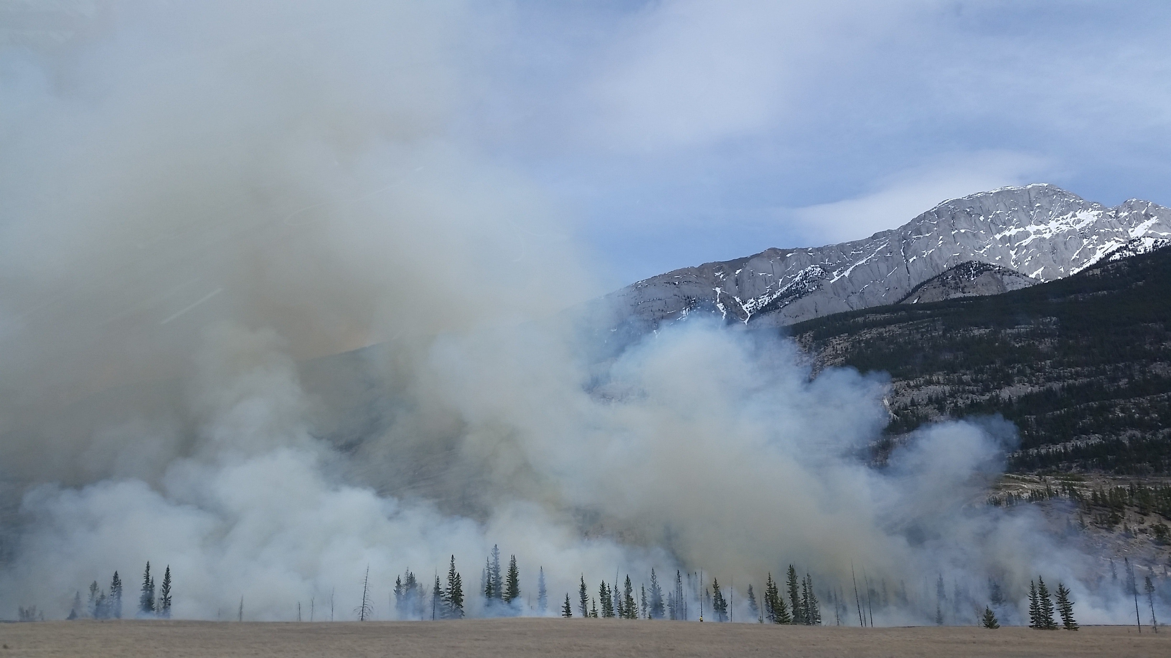
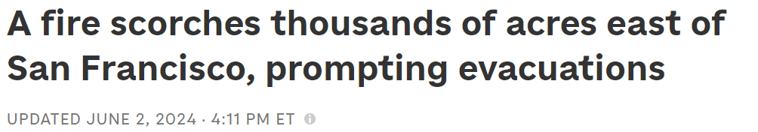

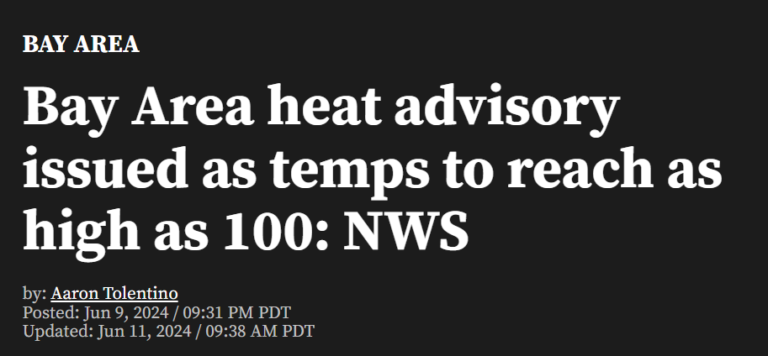

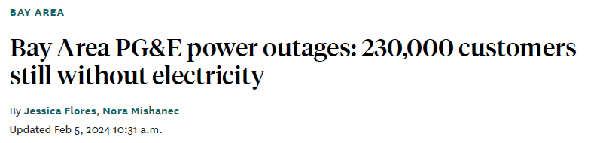

Notes:
These are some headlines from 2023 and 2024, showing news about local wildfire smoke, heat waves, and power shut offs.
This demonstrates that these events are already happening and are going to continue.
These will have real impacts for our community – with infrastructure impacted, businesses closing, impacts to human health, and more.

Slide 5

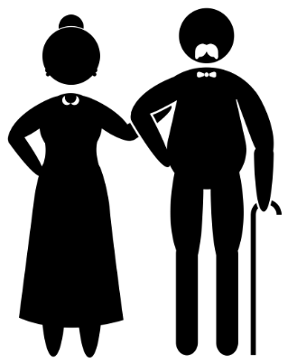
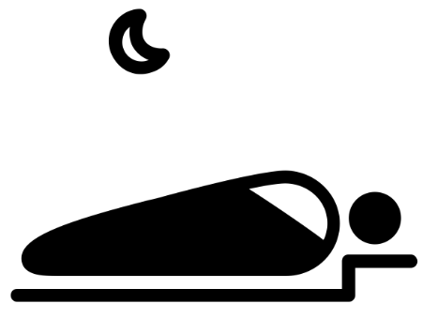
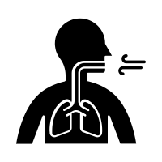

Whose Health Is Affected?
Older Adults
Children
People with Medical Conditions
People with Disabilities
Low Income Residents
Communities of Color
Indigenous Communities
People Living Alone
People who are Unhoused
Outdoor Workers
The Noun Project
Notes:
Who is going to be impacted by these types of events? Frontline communities will be impacted first and worst by climate change. Frontline residents may not have resources to adapt or respond. These include older adults, children, people with medical conditions, people with disabilities, low-income residents, communities of color, indigenous communities, people living alone, people who are unhoused, and outdoor workers.
Residents may also face multiple vulnerabilities at once.

Slide 6
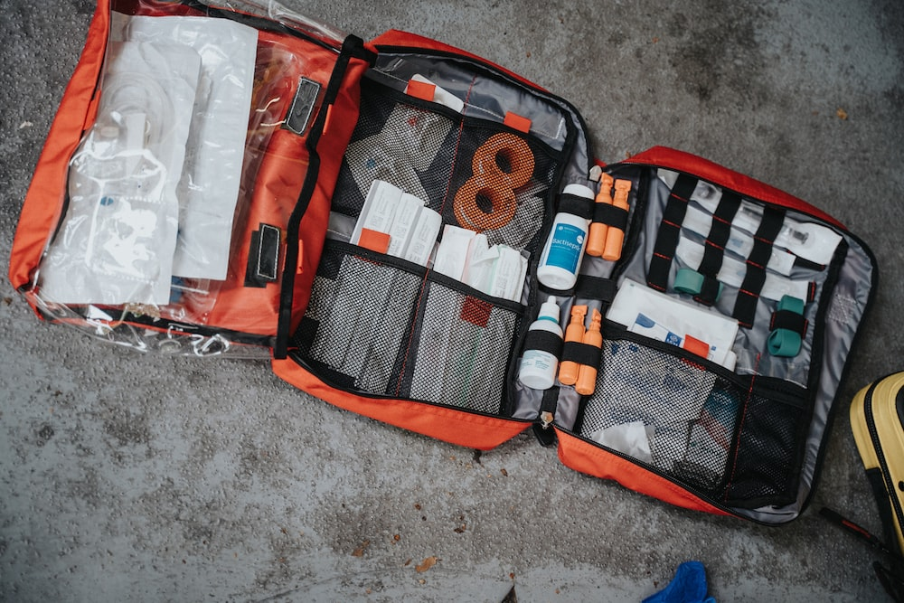
Climate Preparedness
Red preparedness kit with many different supplies
Photo by Mat Napa on Unsplash: Orange white and black bag photo – Free First aid Image on Unsplash
Notes:
To start off, we will cover climate disasters preparedness. Disasters can happen unexpectedly, so it’s important to be prepared in advance
Before we dive in, can we get a show of hands, who has a preparedness kit prepared at home?

Slide 7


Preparedness
Learn More →
www.Ready.gov.org
Sign up for emergency and evacuation alerts
Follow local agencies: Fire, Sheriff
Connect with your neighbors
Have designated meeting spots
Review with friends and/or family
Visit ready.gov/kit
Volunteer to help others
Strengthen your community
To learn more visit: acgov.org/ready/
involved
Notes:
The first step inbeing prepared is knowing the events that occur locally. You can learn about these events by signing up for emergency and evacuation alerts, which we’ll discuss later. And following Alameda County local agencies such as Fire and the Office of Emergency Services to stay up to date on events happening in the County.
Step 2 consists of having a plan. Review your evacuation plan with your family and/or friends and have a designated meeting spot for evacuations. For example, know the quickest route to exit your area if a wildfire approaches your home.
Step 3 is making a preparedness kit. We’ll talk more about this on the next slide.
Lastly, step 4 is getting involved. You can sign up to volunteer to help others and strengthen your community by visiting acgov.org/ready/involved

Slide 8


https://www.ready.gov/kit
Recommended Items to Include in a Basic Emergency Supply Kit
Additional Items to Consider Adding to an Emergency Supply Kit
Prescription medications and glasses
Water and non-perishable food for several days
Infant formula and diapers
Extra cell phone battery or charger ​
Pet food, water and supplies for your pet
Battery-powered or hand crank radio that can receive NOAA Weather Radio tone alerts and extra batteries
Important family documents such as copies of insurance policies, identification and bank account records in a portable waterproof container
Cash and change
Flashlight and extra batteries
Emergency reference material such as a first aid book or information from www.ready.gov
First aid kit
Sleeping bag or warm blanket for each person. Consider additional bedding if you live in cold-weather climate
Whistle to signal for help
Dust mask, to help filter contaminated air and plastic sheeting and duct tape to shelter-in-place
Complete change of clothing including a long sleeve shirt, long pants and sturdy shoes. Consider additional clothing if you live in a cold-weather climate
Moist towelettes, garbage bags and plastic ties for personal sanitation
Fire extinguisher
Matches in a waterproof container
Non-sparking wrench or pliers to turn off utilities
Feminine supplies, personal hygiene items and hand sanitizer
Can opener (if kit contains canned food)
Mess kits, paper cups, plates and disposable utensils, paper towels
Local maps
Paper and pencil
Books, games, puzzles, or other activities for children
Notes:
Visit ready.gov/kit to view a checklist of items to include in your preparedness kit
pack water and food for several days, ideally 1 gallon of water per person per day
pack all items together in a durable bag and store it in an easily accessible place where it can be quickly grabbed when you need to go
family members can pack individual bags that include items such as clothes, personal belongings, and entertaining activities for kids
And don’t forget to pack essential needs for special family members such as pet food for your dog or life saving medications for an older adult in the family
Create a prep kit for your home, work, and car
And refresh your kits every year to ensure all food and medication are not expired

Slide 9

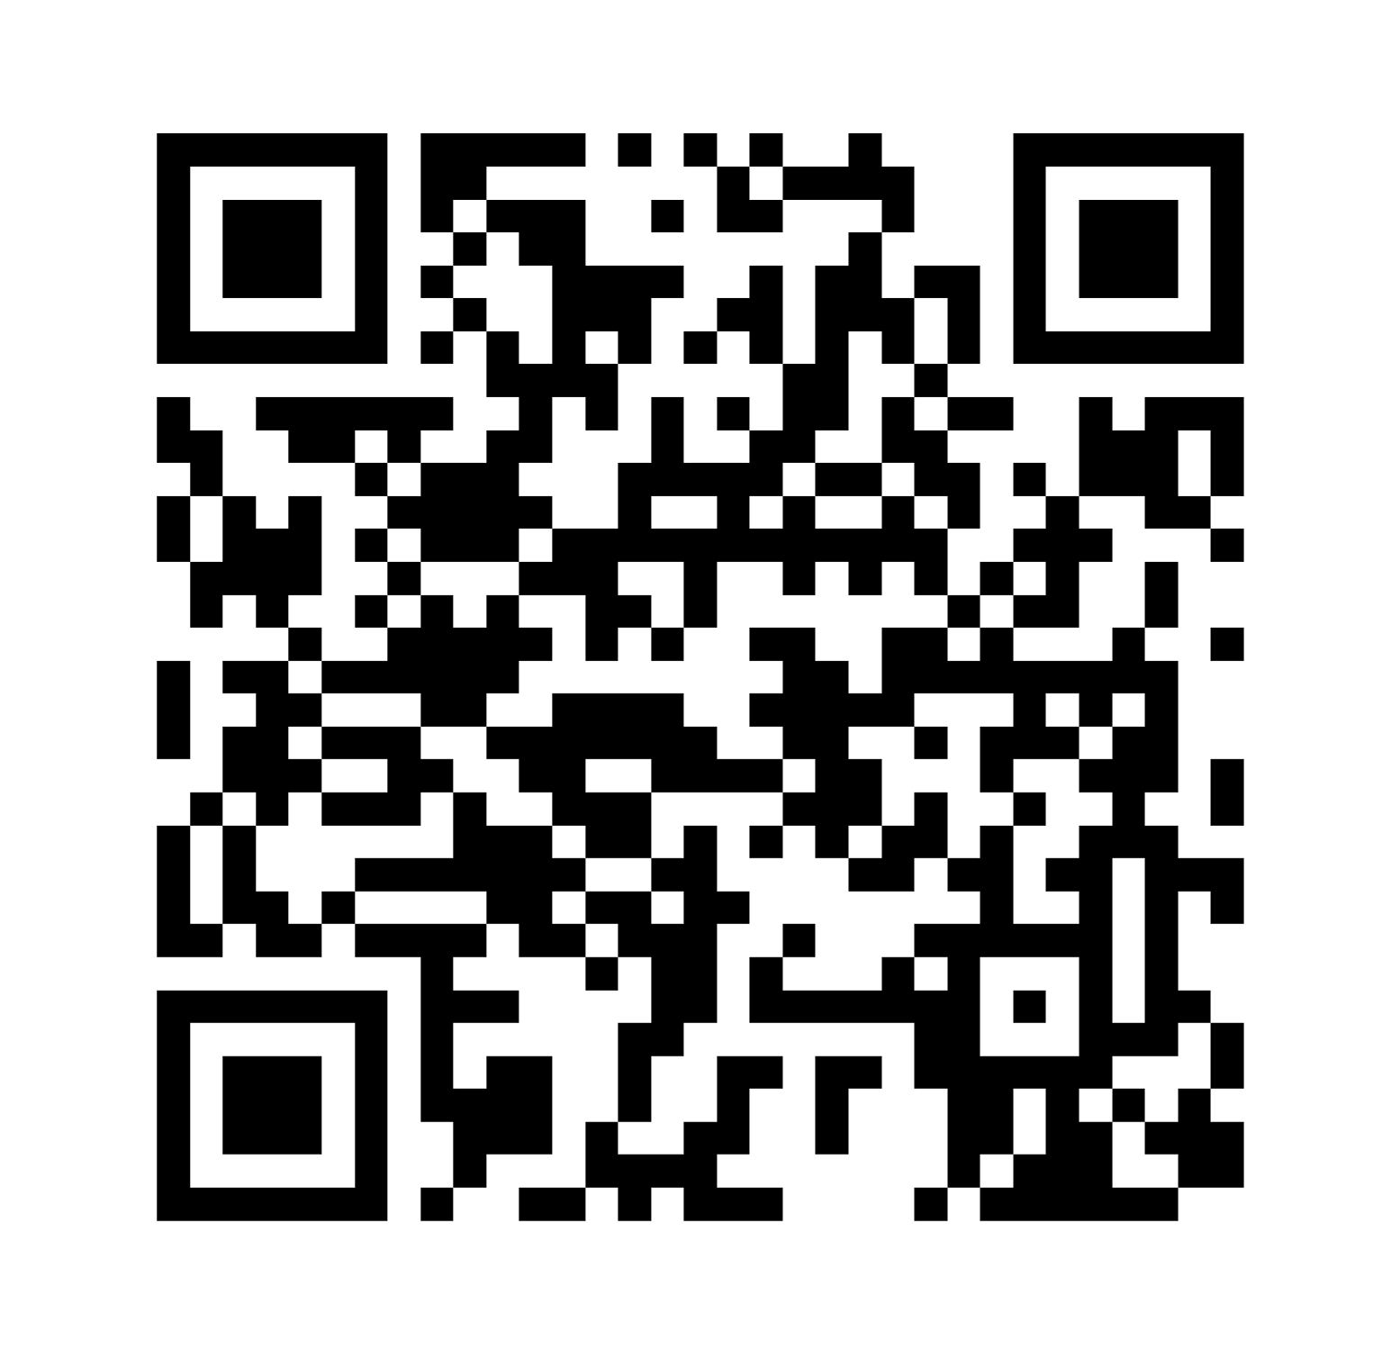
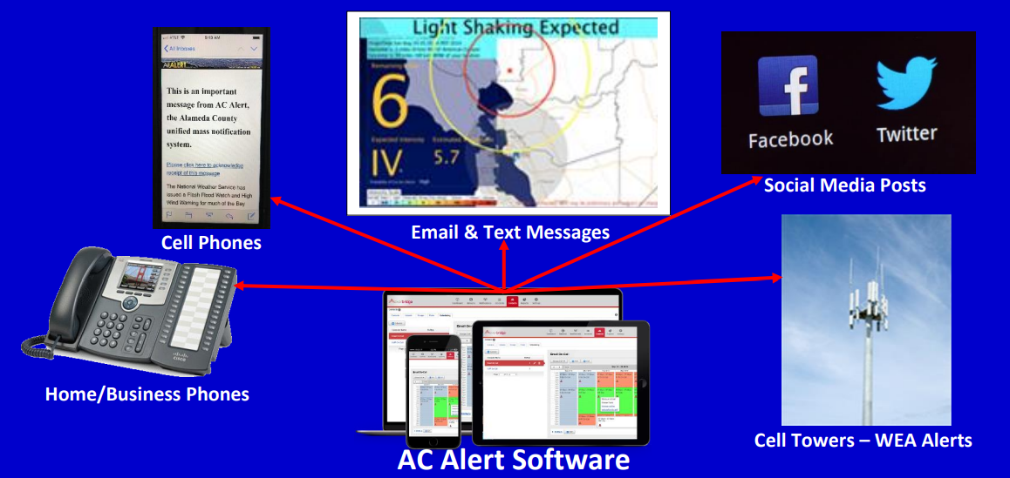
Communication
When an emergency threatens lives, it’s critical that we can reach you!
Alameda County Alert (AC Alert) sends you emergency messages to your chosen device for events in Alameda County
Sign up: ACAlert.org
QR code
Notes:
Visit ACAlert.org to sign up for our messaging system to be alerted of climate related disasters, earthquake information, and other hazards
When an emergency threatens lives, it’s critical that we can reach you
AC Alert sends you emergency messages to your chosen devices for events in the County
You can receive alerts as a text message, email, or even phone call to a land line

Slide 10
Local Social Media:
Alameda County Fire Department
  @AlamedaCoFire on Instagram and X
  @AlamedaCountyFire on Facebook
Alameda County Office of Emergency Services
  @AlamedaCoAlert on X
  @Alamedacountyoes on Facebook
Alameda County Sheriff’s Office
  @ACSOSheriffs on X and Facebook
  @Alamedacountysheriff on Instagram
Local NextDoor networks or Facebook groups
Notes:
Follow our local preparedness social medias to stay up to date on events in the County

Slide 11
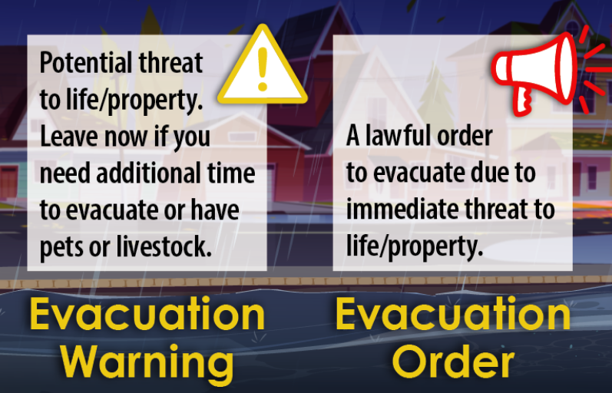
Evacuation Warning vs Evacuation Order
Evacuation Order
  Leave immediately
  Your life is in danger
Evacuation Warning
  Serious threat
  Get ready to go
  Go now if people or animals need extra time
Shelter in Place
  Stay indoors
Cal OES
Notes:
Depending on the severity and type of disaster, you could receive an evacuation order, evacuation warning, or shelter in place order
an evacuation order means leave immediately because your life is in danger
an evacuation warning means there is a serious threat, and you should get ready to go and you should go now if people or animals need extra time
shelter in place means stay indoors and take precautions
for example, when the air quality is very unhealthy for the general public

Slide 12
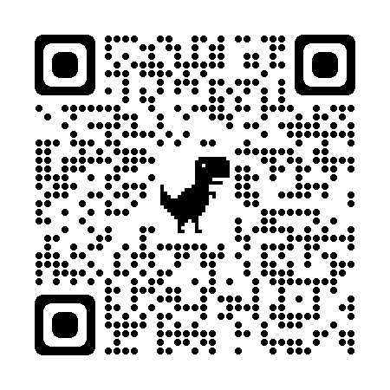
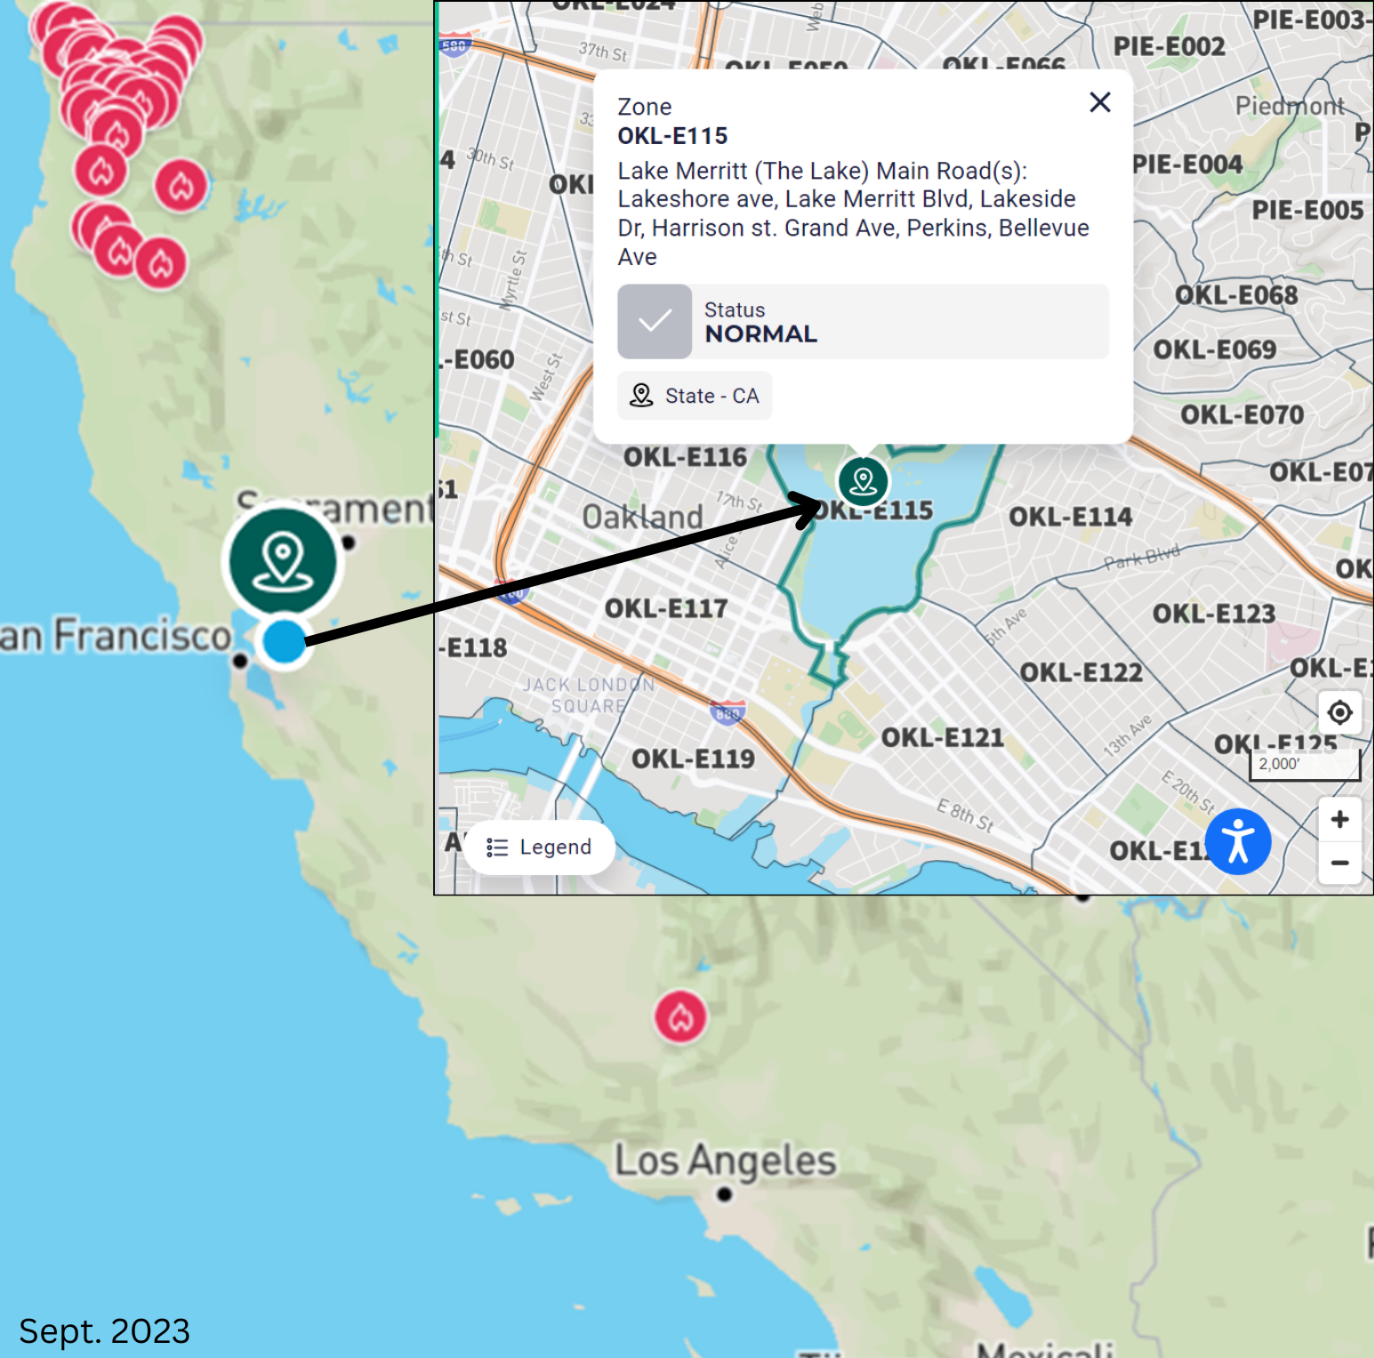

Evacuation
Notifications
Find your zone to prepare for emergencies: protect.genasys.com/search
Evacuation Order​ | Red​ | Immediate threat to life. This is a lawful order to leave now. The area is lawfully closed to public access. ​
Evacuation Warning ​ | Yellow​ | Potential threat to life and/or property. Those who require additional time to evacuate, and those with pets and livestock should leave now. ​
Shelter in Place​ | Purple​ | Go indoors. Shut and lock doors and windows. Prepare to self-sustain until further notice and/or contacted by emergency personnel for additional direction. ​
Advisory​ | Blue​ | Be on alert and follow County recommendations ​
Evacuation Order Lifted ​ | Green​ | It is safe to return to your home. Be aware of your surroundings. ​
Map, pinpointing zone “OKL-E115”
Notes:
The County uses a tool called Genasys Protect (formerly ZoneHaven) to help communities prepare for evacuations BEFORE a disaster strikes. Genasys Protect works with local emergency planners and first responders to guide decision making around if, when, and where to order evacuations, while prioritizing the most vulnerable areas
You can download the Genasys Protect app with a smartphone or search your zone at protect.genasys.com/search
from there, you can enter your address to check the status of your area and share your location with Genasys for automatic population of data
if the zone is activated for an evacuation order, evacuation warning, or shelter in place, you will see additional information regarding the reason for the activation

Slide 13
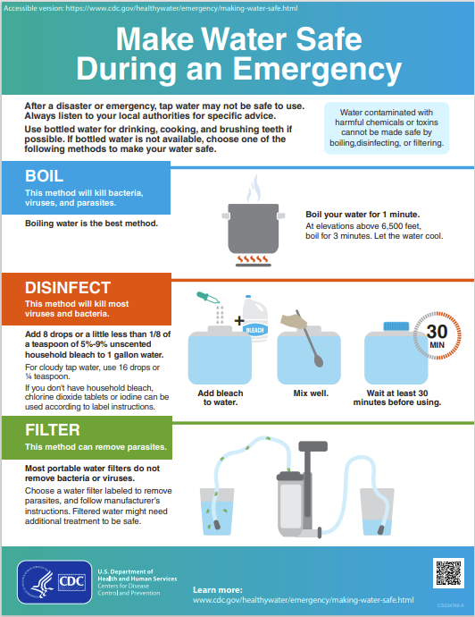
Safe Drinking Water
In addition to the 1-3 days of water in your preparedness kit, you can prepare to make water safe during a disaster:
Boil water for 1-3 minutes
Disinfect water by adding 8 drops of bleach to 1 gallon of water
Filter water with a commercial water filter
https://www.cdc.gov/healthywater/emergency/making-water-safe.html
Notes:
Safe drinking water may not be available during or after many climate related disasters
In addition to having a supply of bottled water, it is also helpful to learn how to treat water
The best method to treating water is to boil it
this will kill bacteria, viruses, and parasites
Boil for 1 minute at elevations below 6,500 ft
And boil for 3 minutes at elevations above 6,500 ft
Disinfecting water will kill most viruses and bacteria
Add 8 drops or about 1/8 of a teaspoon of 5-9% unscented household bleach to 1 gallon of water
Mix well and wait 30 minutes before using
Lastly, filtering water can remove parasites
There are multiple types of water filters so just follow the manufacturer's instructions
Note, filtered water might need additional treatment to be safe

Slide 14
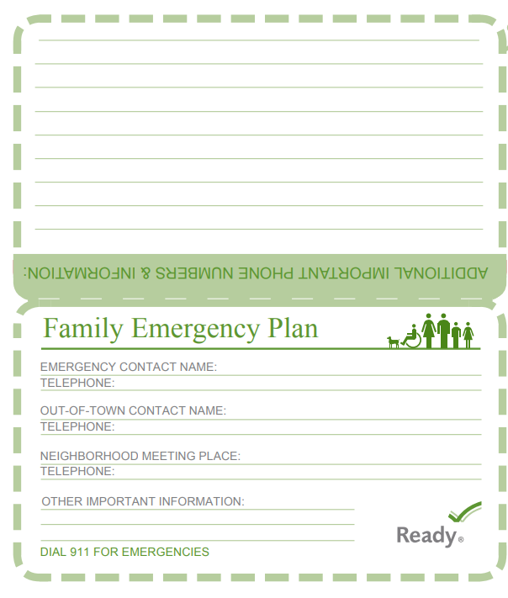
Emergency Contacts
Sister
LA family
Park
Write out your emergency contacts to identify who you can contact in these climate events if you need help
Include those you might want to check on or assist
Helpful to have out-of-town contacts as well
Write out emergency contact numbers
County emergency pocket guide includes Family Emergency Plan section
Parent
Aunt – has breathing problems
Community Organization
Church
Neighborhood Group
Parent Group
Reference: FEMA Ready.gov
Notes:
This visual is borrowed from FEMA’s Ready.gov, the emergency preparedness website, which shows a way to think about how residents can stay connected to one another.
This graphic highlights writing out phone numbers and names for an emergency contact, out-of-town contact, and neighborhood meeting places. In the sections for additional information, you can add information for community organizations and support networks that may help you during a disaster.
Write out your emergency contacts to see who you might need to check on, get in touch with, or ask for help during extreme weather events.

Slide 15
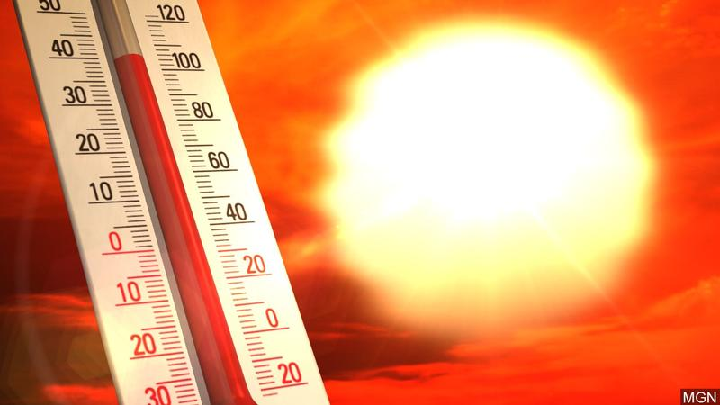
Extreme Heat
Sun beaming with red skies and thermometer reading 100 degrees F˚
Notes:
Next, we will review heat and its impacts

Slide 16
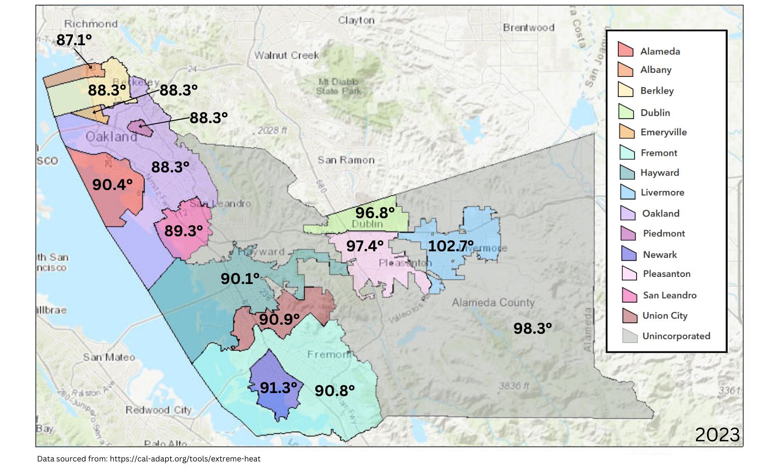
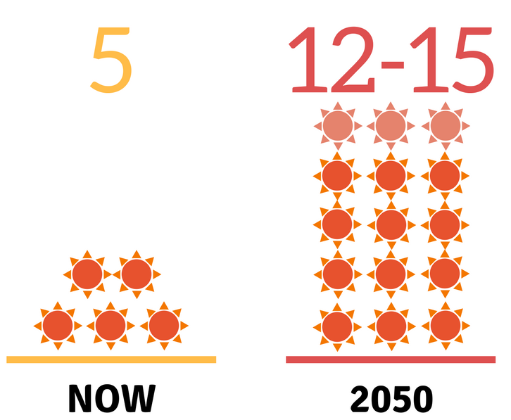

Climate Impact: Extreme Heat
Projected Average Number of Extreme Heat Days
Annually in Alameda County
Extreme Heat Days
16
Reference: CalAdapt
Notes:
In general, an extreme heat day in Alameda County is defined as days where the temperature is above 92.6 degrees. However, each city has a more accurate representation of an extreme heat day for that area. Extreme heat days range in temperature in the County from 88.3 degrees in Oakland, up to 102.7 degrees in Livermore.
CalAdapt, which is a database for climate data, shows that regionally across Alameda County we are expecting about 5 extreme heat days annually. This is expected to go up to about 16 days by mid century.
Even thought right now you can have relief during the night, as we get further into high temperatures, the nights are getting hotter, so you won’t get that relief from the high temperatures at night
[As a reference, in parts of our County, extreme heat days are defined as days where the temperature is above 92.6 degrees.]

Slide 17
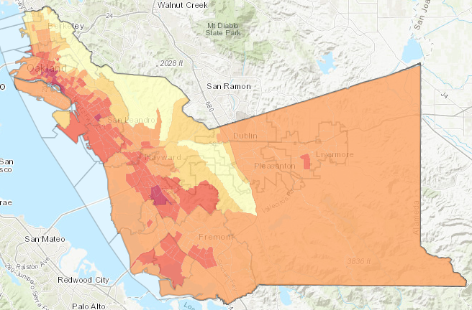
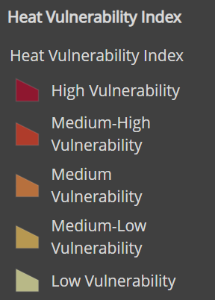
Heat Vulnerability Map
Heat Vulnerability in Alameda County (arcgis.com)
Notes:
This slide shows heat vulnerability from a composite map based on census tracts and represents the social and environmental factors that contribute to community heat vulnerability in Alameda County
Overlapping social vulnerabilities and built environment factors, such as a high percentage of lower income people and renters, lower tree canopy cover, and older housing without air conditioning, make areas of the County particularly vulnerable to extreme heat
There is a number of vulnerability factors related to heat
And areas with the highest heat vulnerability in the County appear in Oakland, San Leandro, and Hayward

Slide 18
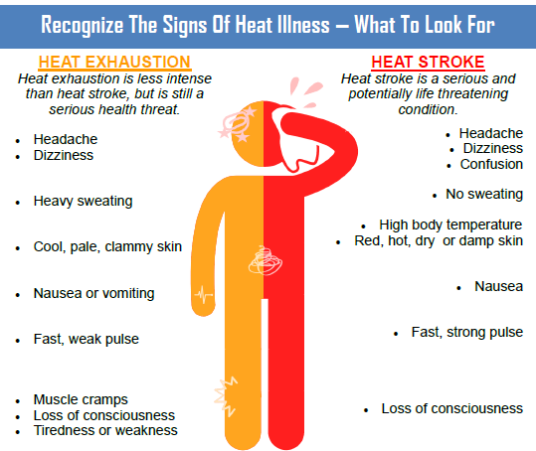
Notes:
Heat exhaustion and heat stroke are two types of heat illness that can affect people during an extreme heat event
This image was developed with information from the public health department and describes some of the symptoms for heat exhaustion and heat stroke
When there is an extreme heat event, you want to keep an eye out for: headaches, dizziness, nausea, and loss of consciousness.
Heat exhaustion can look similar to heat stoke. Both are serious, but heat stroke is potentially life threatening
Someone experiencing heat stroke may not sweat and may show confusion

Slide 19
Extreme Heat:
Who is most vulnerable?
People with medical conditions: may experience sensitivities to heat
Older adults: tend to sweat less
The unhoused: constant outdoor exposure
People living in homes without air conditioning or do not run the air conditioning because of cost: don’t feel relief from AC
Outdoor workers: construction, landscaping, public works, agricultural
Isolated individuals: who do not have people checking in on them
Intersecting vulnerabilities increase risk
Reference: CDPH
Notes:
So who is the most vulnerable to extreme heat?
People with pre-existing health conditions may be more sensitive to heat.
Older adults are more sensitive because they tend to sweat less which is one of the ways that the body keeps cool
People who are unhoused, they experience constant outdoor exposure
People living in homes without air conditioning or who cannot run the air conditioning due to costs are at risk since they can’t feel relief from the AC
Outdoor workers such as those who work in construction, landscaping, public works, or agriculture are exposed to extreme heat during work hours
And People who are socially isolated have a significant risk of becoming injured or passing away due to heat related illness if they don’t have someone checking in on them
Intersecting vulnerabilities will also increase risk
For example, an older adult who lives alone has a greater risk factor to extreme heat
https://www.cdph.ca.gov/Programs/EPO/Pages/BI_Natural-Disasters_Extreme-Heat_Seniors-and-Heat-Illness.aspx
https://www.cdph.ca.gov/Programs/EPO/Pages/BI_Natural-Disasters_Extreme-Heat_Tips-for-Preventing-Heat-Related-Illness.aspx
Image source: EPA: Climate Change and the Health of Older Adults

Slide 20
Extreme Heat:
How to prepare and stay safe
Stay hydrated
Stay in air conditioning (esp. when temp.’s high 90+)
Wear loose, lightweight, light-colored clothing
Shower/bathe in cool water
Cool cloths on neck, hands, and feet
Avoid strenuous activities
Visit a Cooling Center
Check on neighbors and community members, esp. elders and those living alone
https://www.acgov.org/emergencysite/
Reference: ACDPH
Notes:
So how can you prepare and stay safe?
You should drink plenty of cool water and stay hydrated
Stay in air conditioning as much as possible, especially when the temperature is in the high 90s
Wear loose, lightweight, and light-colored clothing
Shower or bathe in cool water
And place cool clothes on your neck, hands, and feet
Avoid strenuous activities, especially outdoors
And you can visit a cooling center. Cooling centers are a great resources to utilize during extreme heat events. These are public places where people can go to access air conditioning during building operational hours such as a library or community center. The best cooling centers are places that you already know and already have a relationship with.
Lastly, if you are able, check in on your family, friends, and neighbors, especially those who are living alone to make sure they are okay during extreme heat events
https://www.cdph.ca.gov/Programs/EPO/Pages/BI_Natural-Disasters_Extreme-Heat_Seniors-and-Heat-Illness.aspx

Slide 21
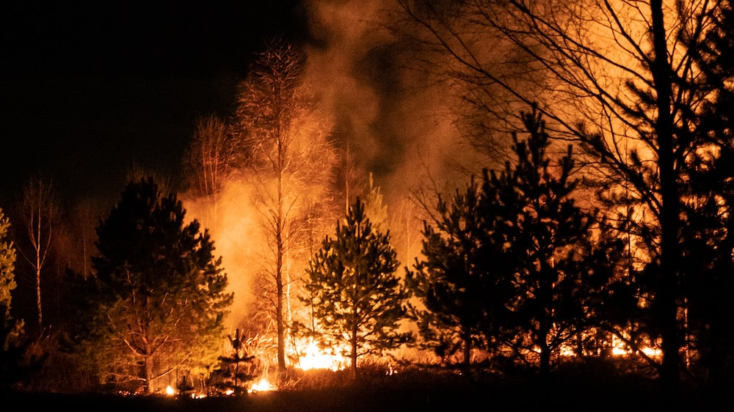
Wildfires
Forest with lots of trees catching fire
Photo by Egor Vikhrev on Unsplash: Silhouette of trees during night time photo – Free Россия Image on Unsplash​
Notes:
For the rest of the presentation, we will cover specific threats, including how the threats might change with the changing climate, best practices, and protective actions.
First, we will address wildfires and related hazards.

Slide 22
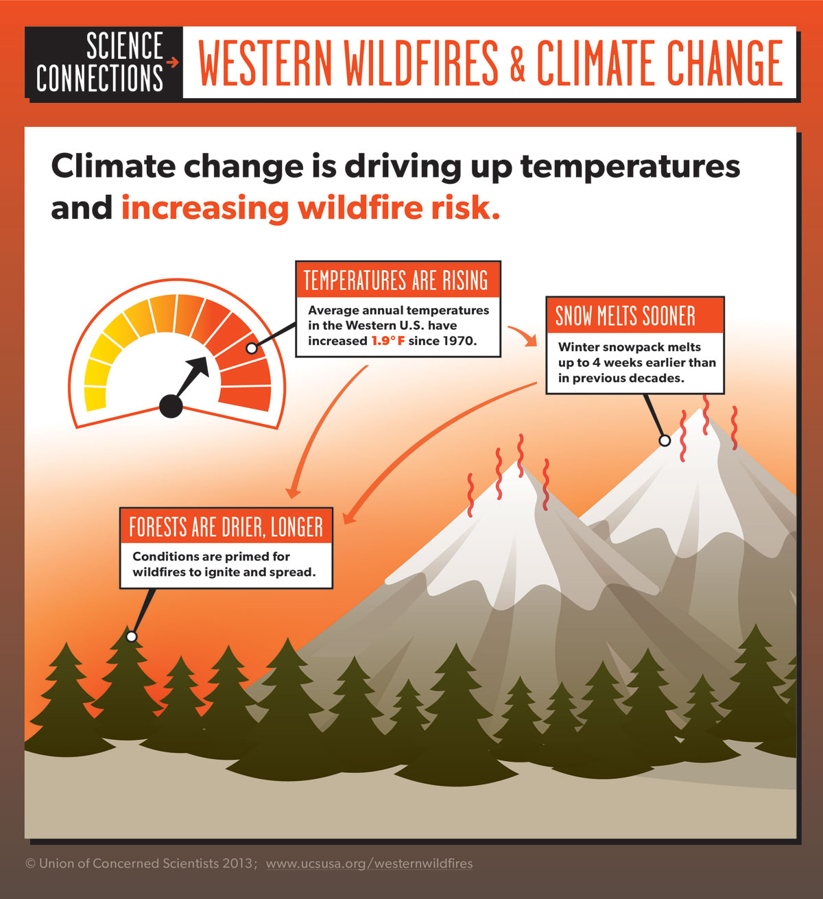
Climate Impact: More Frequent and Severe Wildfires
TEMPERATURES
ARE
RISING
TEMPERATURES
ARE
RISING
SNOW
MELTS
SOONER
SNOW
MELTS
SOONER
FORESTS ARE
DRIER, LONGER
FORESTS ARE
DRIER, LONGER
Notes:
With climate change, we have higher temperatures as well as snow melt happening sooner.
Both of these conditions combined result in a longer, drier season which leads to more frequent and severe wildfires.
Image Credit: Union of Concerned Scientists. https://www.ucsusa.org/global-warming/science-and-impacts/impacts/infographic-wildfires-climate-change.html#.WqGJ2OjwaM8

Slide 23
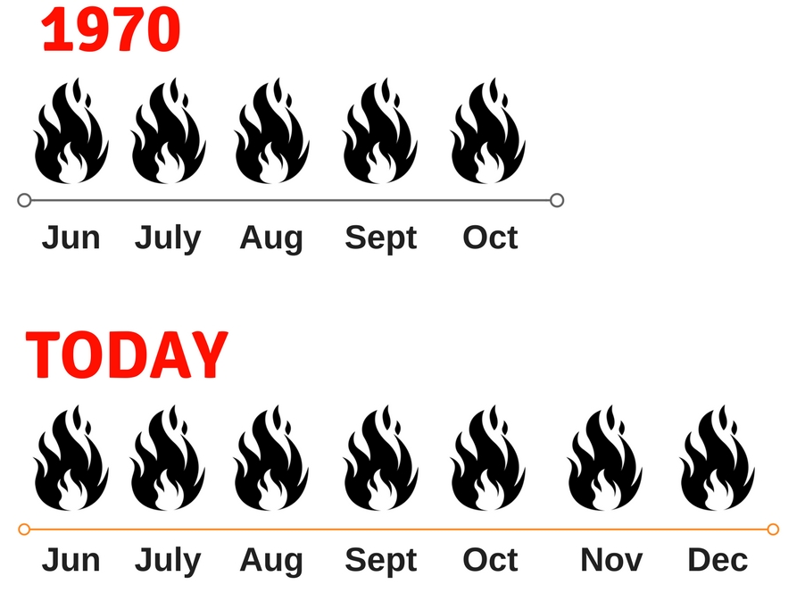
Longer Wildfire Season
Notes:
Also due to dry conditions, what used to be a 5 month fire season in 1970, is now 7 months of fire season. This is our new normal. We're seeing this happen year after year and that is resulting in smoke events, fire risk, power shutoffs, and more for the Bay Area
Image Credit: Union of Concerned Scientists. https://www.ucsusa.org/global-warming/science-and-impacts/impacts/infographic-wildfires-climate-change.html#.WqGJ2OjwaM8

Slide 24
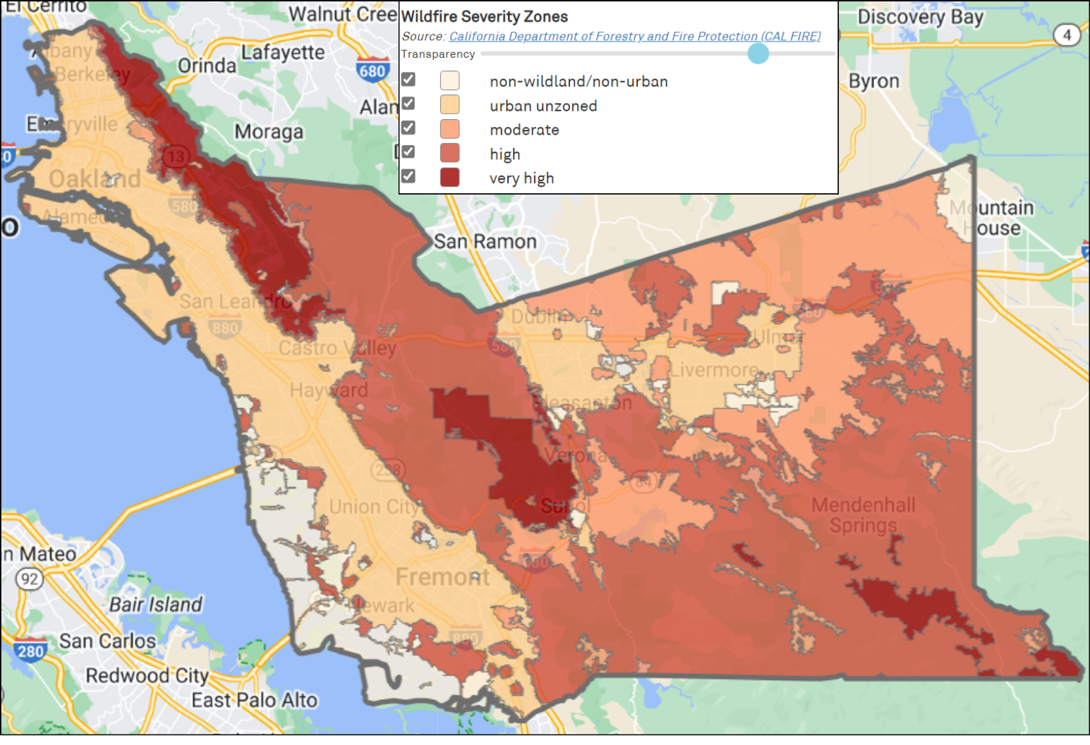
Wildfire Severity Zones
Alameda County Local Hazard Mitigation Plan (acgov.org)
Notes:
Here is a map of the wildfire severity zone in Alameda County
As you can see, the East Bay Hills, the central county, and areas in the southeast section of the county have a very high wildfire severity
Factors such as fire likelihood, fire behavior, fire history, existing and potential fuel (natural vegetation), terrain, weather, etc. Are used to classify the lands

Slide 25
Wildfire:
Who is most vulnerable?
Older adults & people with disabilities: consider evacuating early to ensure extra time due to mobility impairments
People living in older homes: homes may be more vulnerable to catching on fire due to flammable building materials
Low-income individuals: may not have access to transportation such as a car to evacuate
The unhoused: very susceptible to the impacts of wildfires. Lives and belongings are at high risk.
Notes:
To allow extra travel time, older adults and people with disabilities may consider evacuating during evacuation warnings or at any point that they feel unsafe. Never wait to be told to leave an unsafe situation
Read slide

Slide 26
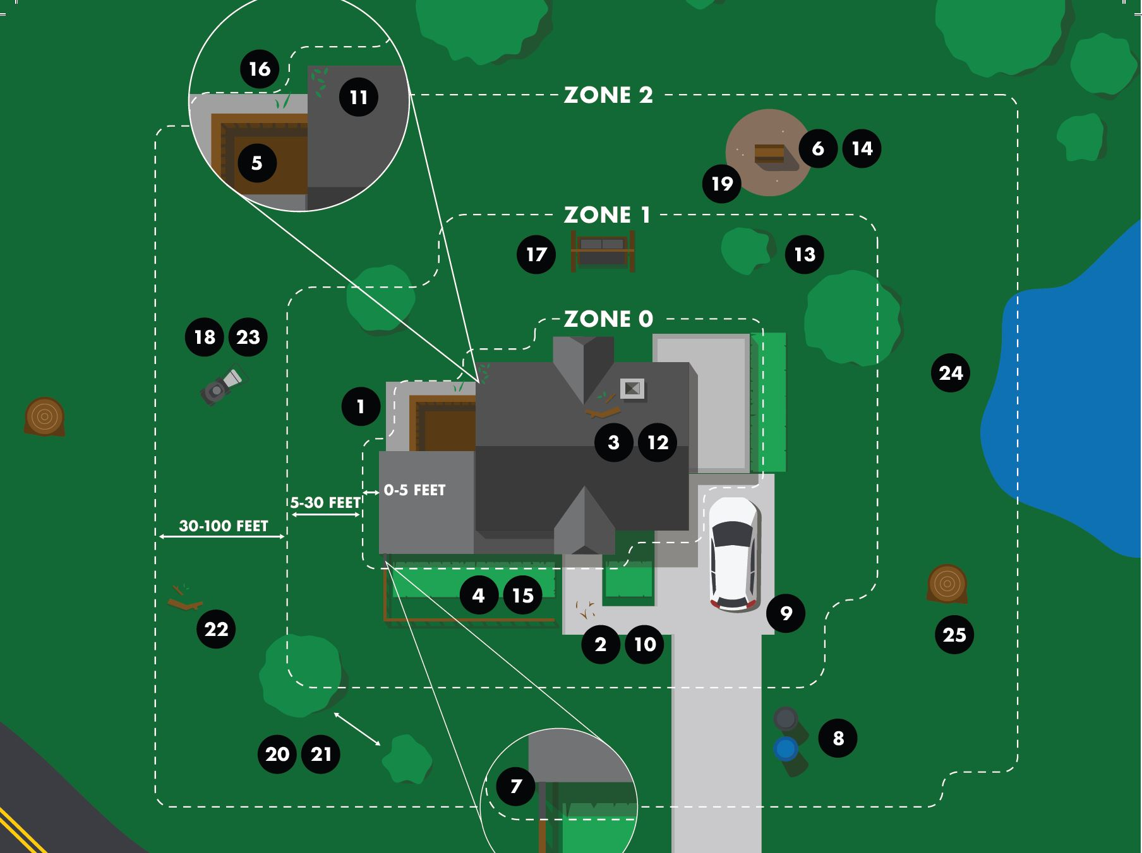
Wildfire:
How to prepare and stay safe
Be aware
Have multiple exits
Working smoke detectors
Create defensible space
Store combustible materials 30 ft away from home
Water the area (if time)
Home updates
Insurance
CalFire
Notes:
In the last 10 years, over half of the wildfires in the US have been caused by humans (according to the USDA Forest Service)
So how can you prepare and stay safe?
Be very aware when burning debris, using electrical equipment, starting campfires, and lighting fireworks
Make sure to thoroughly put out any human started fires
Know how to exit each room in at least two ways in case you must evacuate
Install smoke detectors and make sure to change the batteries
Have a smoke detector in each bedroom and in the hallway outside the bedrooms
If you are a homeowner:
Create defensible space
This means reducing fire fuel (vegetation)
In zone 0, 0-5 ft away from the house
Use hardscape materials like gravel which is not combustible
Remove dead brush and leaves from the gutters, roof, and deck
In zone 1, 5-30 ft away from the house, and zone 2, 30-100 ft away from the house
Mow annual grass to a maximum of 4 inches
Remove dead brush and leaves from the yard
Regularly trim trees and shrubs
Store combustible materials, such as propane tanks and firewood, at least 30 feet away from your home
Use your hose to spray water over your yard and roof, if a fire is on the way and you have time
Update your home with fire smart upgrades, if possible
Build your roof with metal, clay, or tile instead of wood or shingles to reduce flammability
Cover vent openings with metal mesh to reduce openings for embers
Install dual-paned windows to reduce the chance of glass breaking
Use ignition resistant building materials for house siding such as stucco instead of wood products such as panels or shingles
Install a metal fence instead of a wooden fence
Consider your options for insurance. In fire-prone areas, residents not served by insurance companies can purchase from the California Fair Access to Insurance Requirements (FAIR) Plan

Slide 27
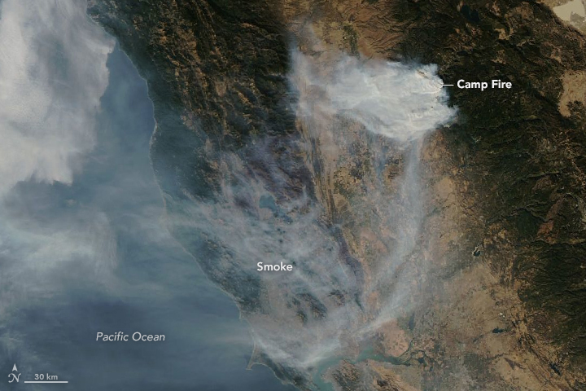
Wildfire Smoke & Poor Air Quality
Notes:
Now we will address wildfire smoke and poor air quality

Slide 28
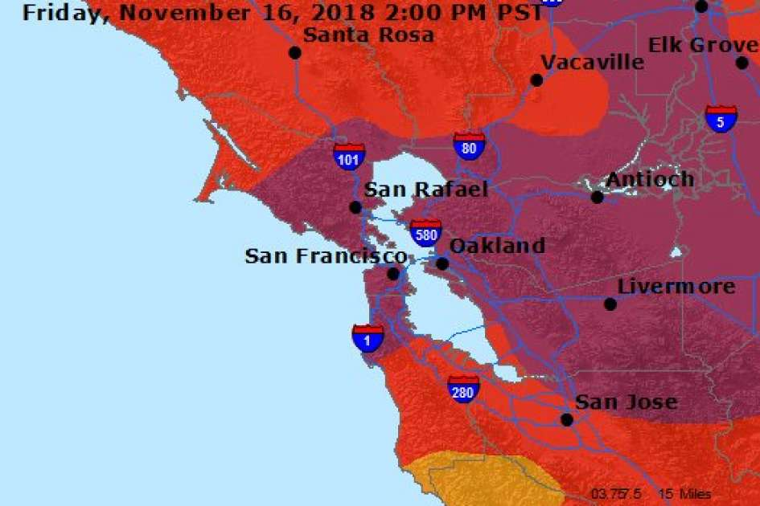
Air Quality Readings
Air Quality Index Levels of Health Concern ​ | Recommendations ​
Good (0-50)​ | No health impacts expected ​
Moderate (51-100)​ | Unusually sensitive people should consider limiting prolonged outdoor exertion ​
Unhealthy for Sensitive Groups (101-150)​ | Stay indoors if you:​ Are pregnant​ Are an infant or young child ​ Are elderly ​ Have asthma or other breathing issues or heart disease ​ Are bothered by smoke ​
Unhealthy (151-200)​ | Everyone, especially children, should limit prolonged outdoor activities ​
Very Unhealthy (201-300)​ | Everyone, especially children, should limit prolonged outdoor activities ​
Notes:
The image on the left is the air quality index which is a measure that assigns colors to the values in the scale.
The numbers correspond to the particulates in the air, and this is scaled to what is healthy or not healthy for particular groups.
At green, 0-50 AQI, no health impacts are expected
At Yellow, 51-100 AQI, it’s OK for most people to be out, unless you are particularly sensitive to air pollution.
Orange, 101-150 AQI, it is Unhealthy for Sensitive Groups such as people who are pregnant, infants and young children, elders, people with medical conditions, or if you are bothered by smoke. They are all advised to limit time outdoors.
At Red and Purple levels, everyone, especially children, is advised to limit or avoid activities and exposure outside. This is for any value over 150 in the air quality index.
This slide also shows a map from the Air District for November 2018 showing the raging fires we experienced.
As you can see, “purple” means Very Unhealthy air quality. This level hadn’t been seen before the 2018 fires in the Bay Area, but here we see the county blanketed with purple. Readings were unhealthy for several days.

Slide 29
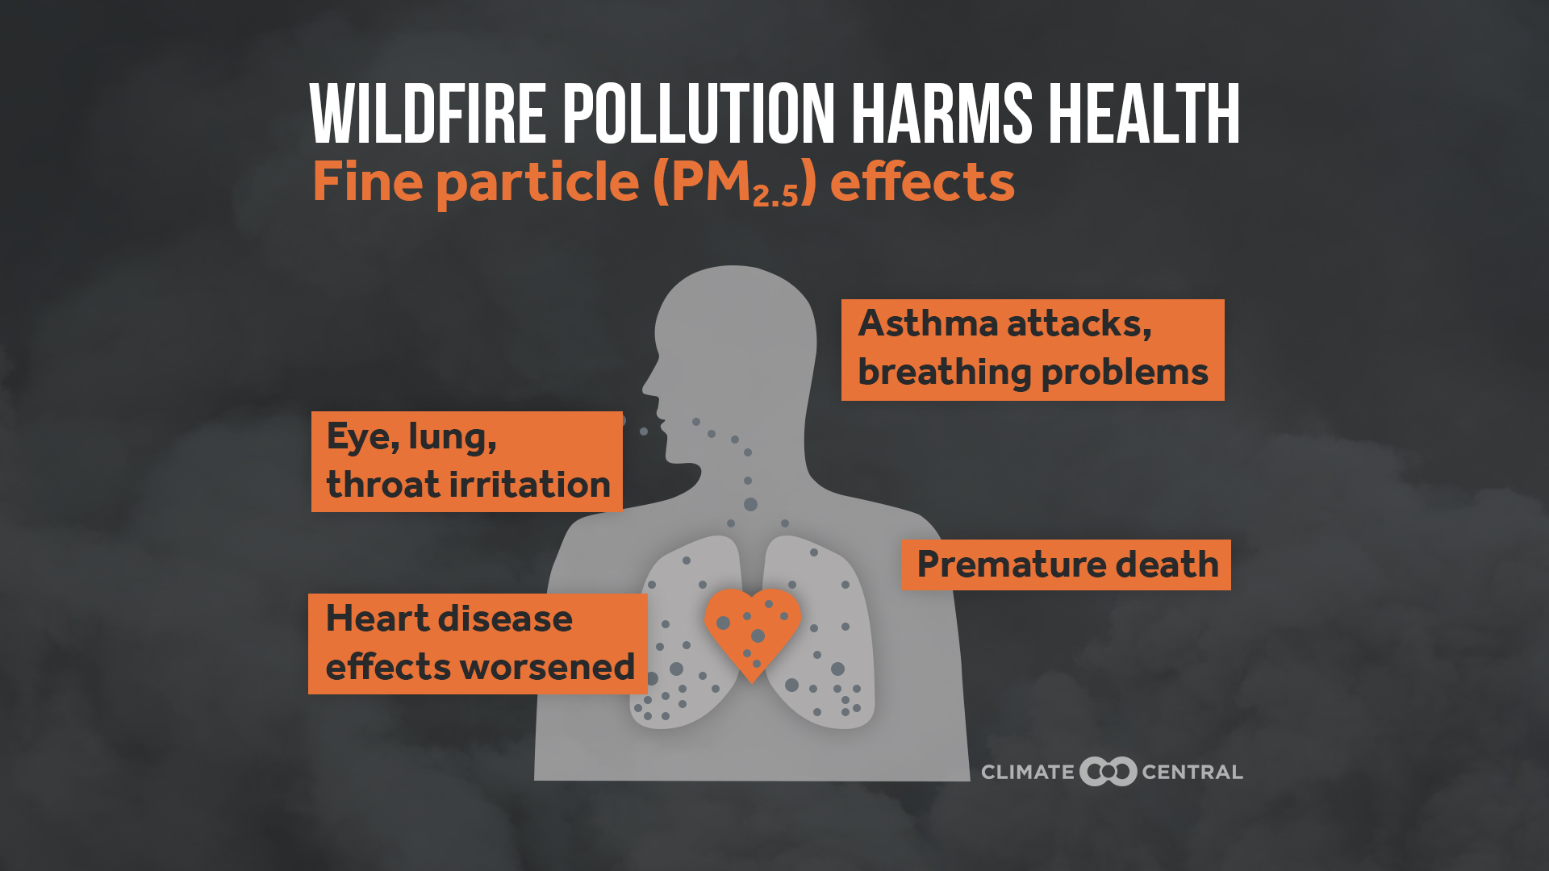
Health Impacts from Smoke
Irritates eyes and airways
Worsens common respiratory conditions, such as asthma and COPD
Can increase risk of heart attack, worsen cardiac issues
Higher risk of long-term effects, esp for children
Can be long-term health impacts even without sudden symptoms like coughing
Reference: Climate Central, ACDPH
Notes:
Smoke and poor air quality can have impacts on human health
Wildfire smoke contains chemicals, gases, and fine particles that can harm our health
Fine particulate matter contains microscopic chemical particles that can pose a great risk to our health
Smoke not only irritates the eyes and airways, but also tends to worsen respiratory conditions like asthma or other kinds of breathing problems.
You can have increased risk of heart attack or other kinds of cardiac issues.
There is also increased risk of long-term effects, particularly for young people whose respiratory systems are still developing.
And there can be long-term effects even if there aren’t sudden symptoms.
Sources; EPA report on older adults and climate change
CDPH report: Climate Change and Health Profile
https://www.ucsf.edu/news/2017/10/408766/long-term-health-impacts-wildfire-smoke-may-include-cardiac-respiratory-effects
COPD = chronic obstructive pulmonary disease

Slide 30
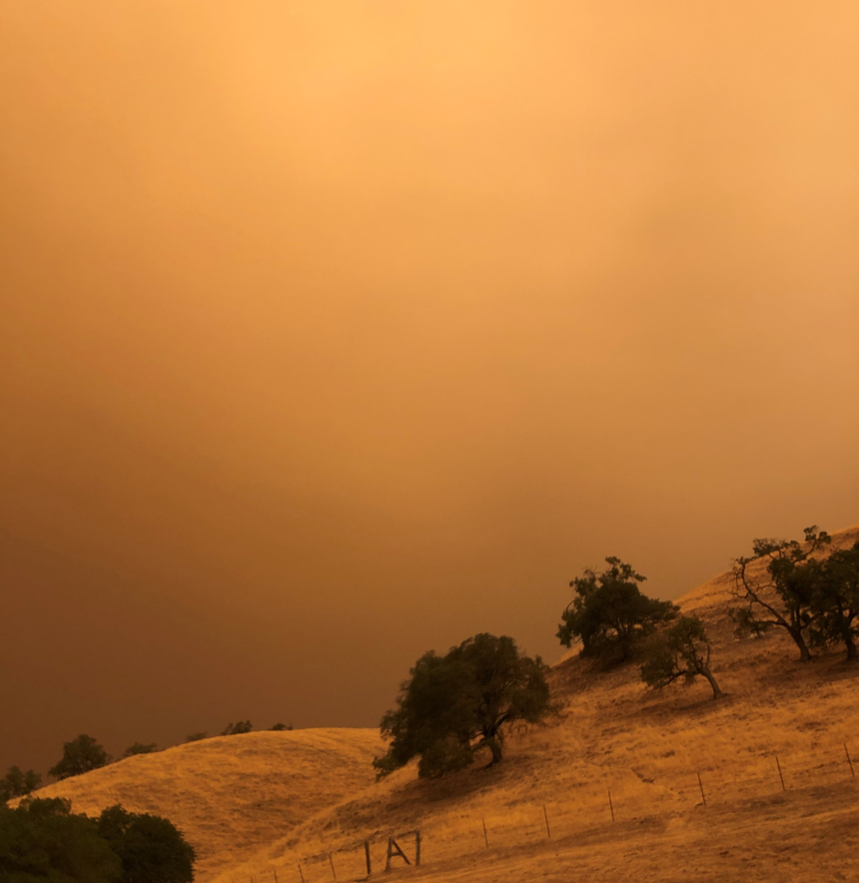
Smoke, Heat, and COVID
The ventilation for smoke and COVID are different
  Outside air is often brought in to prevent COVID spread
  Outside air is harmful in smoke conditions
How can I filter air in my home?
  Even without filtered air, staying indoors is the best way to reduce smoke exposure. To filter air, consider a portable HEPA air purifier (make sure it does not produce ozone) or a MERV 13 or greater filter for your HVAC system.
What should you do if all hit at once?
  Stay indoors with doors and windows closed
  Stay hydrated
  Keep cool. Place cool towels over hands, face, feet. Watch for signs of heat illness.
  Limit physical activity outdoors, like running, biking, physical labor, and sports.
  Keep indoor air clean.
  Visit a Cleaner Air Center
  Create plan with neighbors or household.
Hills overlooking
orange, smokey skies
Alameda County Smoke and COVID FAQ
Notes:
Something to keep in mind is that the ventilation for smoke and COVID are different. On a smoky day, outside air is harmful. Staying indoors can protect against smoke.
If you want to filter your indoor air, consider a HEPA air purifier or a MERV 13 filter for HVAC air conditioning.
Generally, if it’s hot and smokey, it is recommended to stay indoors and hydrated, have cool towels on your hands and your feet, limit outdoor activities, and stay in touch with your neighbors and your household.
https://covid-19.acgov.org/covid19-assets/docs/health-safety/wildfire-smoke-faq-2020.08.28.pdf

Slide 31
Wildfire smoke and poor air quality: Who is most vulnerable?
People with diabetes, heart or lung disease: such as heart failure, angina, ischemic heart disease, chronic obstructive pulmonary disease, emphysema or asthma.
Older adults: elderly more likely to have heart or lung disease than younger people.
Children, including teenagers: their respiratory systems are still developing, they breathe more air (and air pollution) per pound of body weight than adults, they’re more likely to be active outdoors, and they’re more likely to have asthma.
Pregnant people: there could be potential health effects for both you and the developing fetus.
People living in old homes: older homes may have more leakage of outdoor air than newer homes or weatherized homes
People working/living outside: construction workers, landscapers, the unhoused, agricultural workers, public works city staff
Reference: CDPH
Notes:
So who is the most vulnerable during smoke and poor air quality events?
People with preexisting medical conditions such as diabetes, heart or lung disease are particularly at risk in wildfire smoke.
And older adults may be as well, as they’re more likely to have these conditions.
Children are at risk because young people have respiratory systems that are still developing, so they breathe in more air and air pollution by body weight, they are more likely to be outside and they're also more likely to have asthma.
For people who are pregnant, there could be potential health effects for them or their fetus.
People who are living in older homes are more likely to have leakage of outside air.
And people living or working outside, such as construction workers, landscapers, agriculture workers, or the unhoused, they are also more exposed to these events.

Slide 32
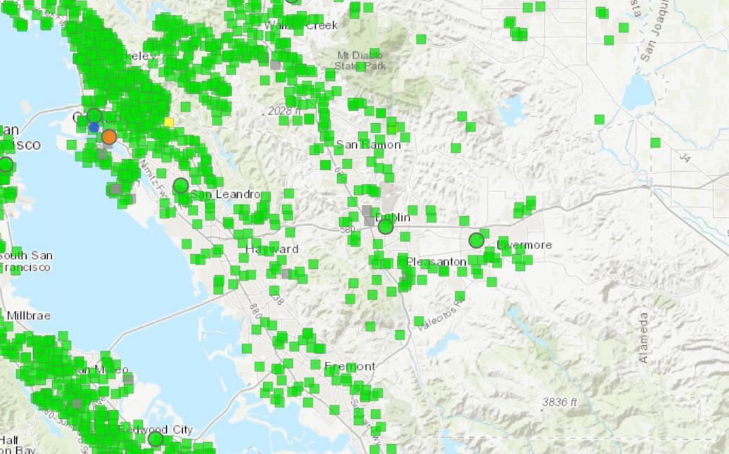
Wildfire smoke and poor air quality: How to prepare and stay safe
Stay indoors
Stay hydrated
Keep cool
Keep indoor air clean
  Consider HEPA air purifier
  Avoid burning candles, vacuuming, using the stove, fireplaces, tobacco
Limit physical activity outdoors
Wear fitted N95, P100, KN95 masks
10-16-2023 @ 10AM
Fire and Smoke Map (airnow.gov)
Reference: ACDPH
Notes:
So how can you prepare and stay safe
The recommended actions are to stay indoors, stay hydrated, and keep cool.
Keep your indoor air clean
If you want to filter your indoor air, consider a HEPA air purifier or a MERV 13 filter for HVAC air conditioning.
Also avoid activities such as burning candles, vacuuming, using the stove, turning on the fireplace, and smoking
limit exercise outdoors.
If you want to wear a mask, you’ll need a fitted N95 type mask
You can Visit fire.airnow to view the up-to-date air quality index. This image is from a good air quality day- as you can see all the green dots- but these will change color if the air quality is poor. For example, you can see that one orange dot in Oakland
https://covid-19.acgov.org/covid19-assets/docs/health-safety/wildfire-smoke-faq-2020.08.28.pdf

Slide 33
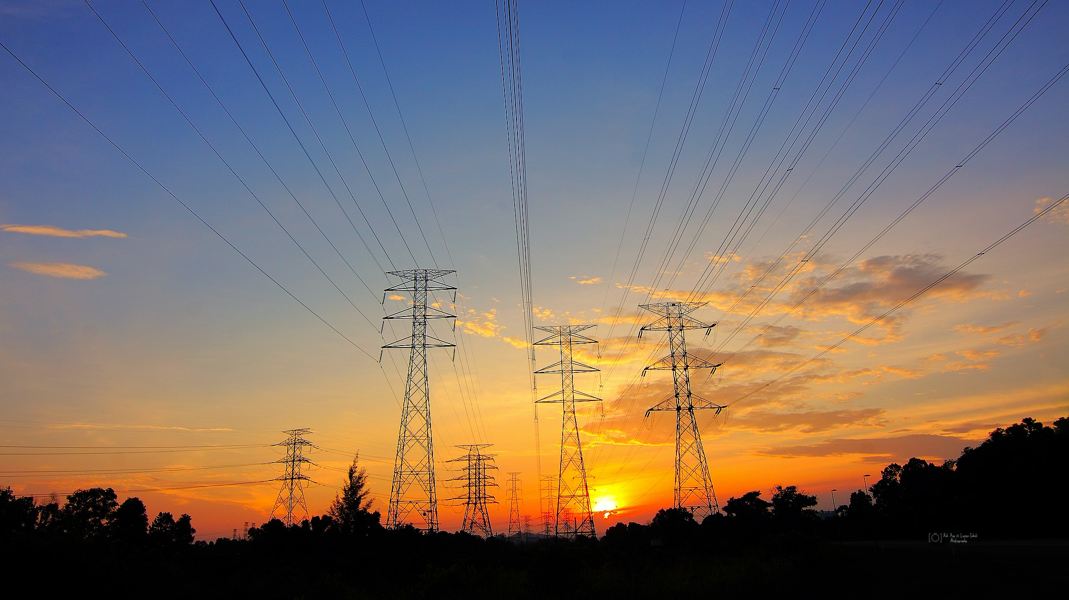
Power Shutoffs & Outages
Notes:
Power Shutoffs are another impact to be aware of. The power may go out in storm conditions, but there may also be planned power shutoffs designed to limit the risk of wildfires.

Slide 34
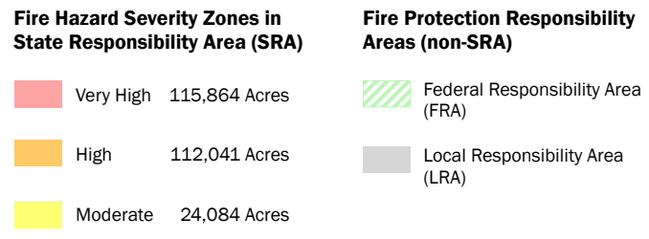
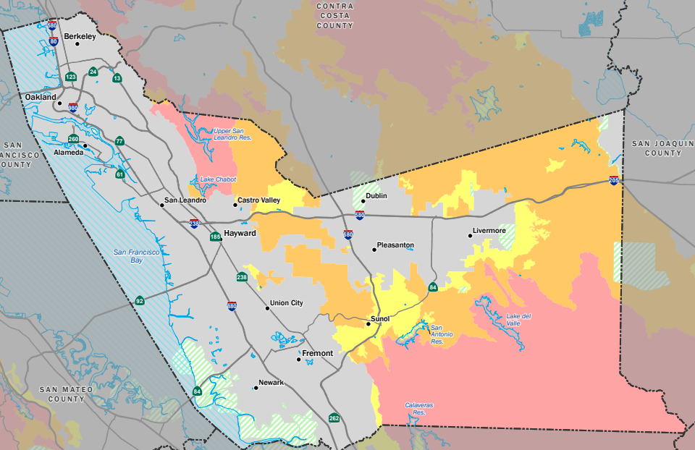
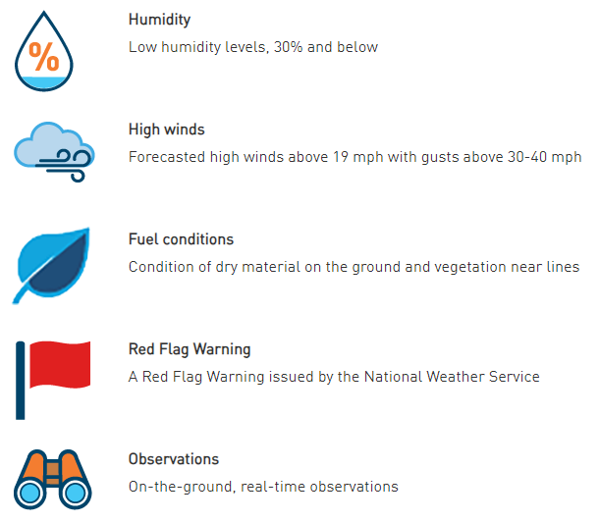
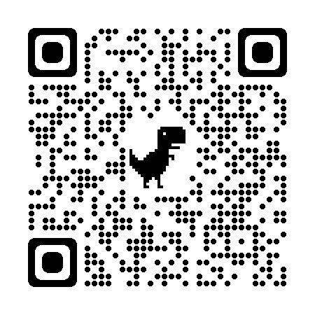
PG&E Public Safety Power Shutoffs (PSPS)
Utilities may temporarily turn off power to specific areas to reduce the risk of fires caused by electric infrastructure- this is called a Public Safety Power Shutoff
PG&E posts up-to-date information about PSPS events and power outages on its website:
pgealerts.alerts.
pge.com/updates/
CalFire Fire-Threat Map for Alameda County (6/15/23)
Humidity
High Winds
Fuel Conditions
Red Flag (Fire Risk) Warning
Observations
Notes:
PG&E may temporarily turn off power to high fire threat areas to reduce the risk of fires caused by electric infrastructure
These are called “Public Safety Power Shutoffs” or PSPS
If there is a PSPS event, PG&E will provide a map of the impacted areas and customers
There are certain conditions that trigger Public Safety Power Shutoffs
These include humidity, high winds, fuel conditions, red flag fire risk warning, and local observations
This High Fire Threat District Map is sponsored by the California Public Utilities Commission (CPUS) and is designed specifically for identifying areas where there is an increased risk for utility-associated wildfire
This fire threat map for the County was captured mid June 2023. There are several areas around the County where we can expect high fire risk zones

Slide 35
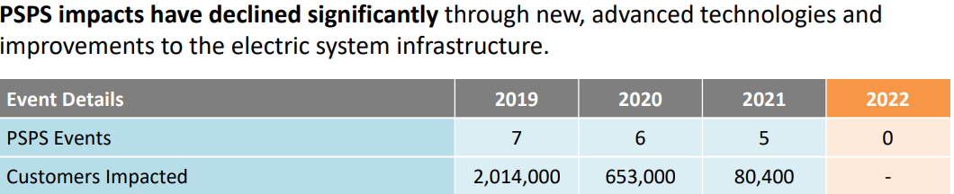
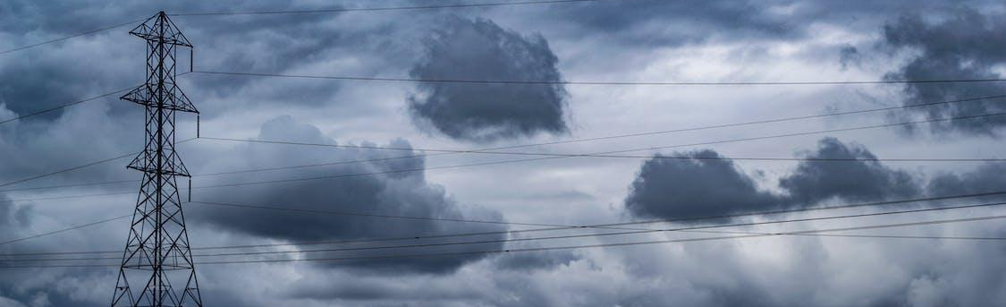
Be prepared for planned or unplanned power shutoffs, caused by storms or fire risk
Photo by Brett Sayles on Pexels
Notes:
You’ll want to be prepared for power shutoffs, even if they are not planned
PSPS impacts have declined with improvements to electric system infrastructure. PSPS are less frequent than they used to be, but they are still of concern, especially for those in high fire risk areas
Power outages can also happen during storms, so you should be prepared to carry on your daily activities without power during extreme storm events

Slide 36
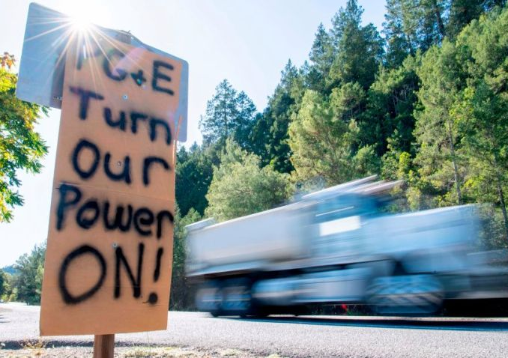
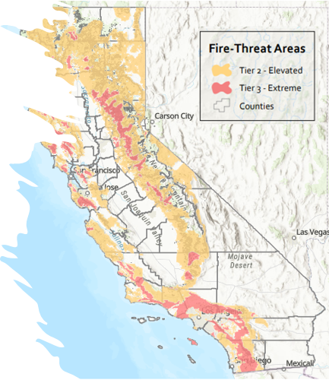
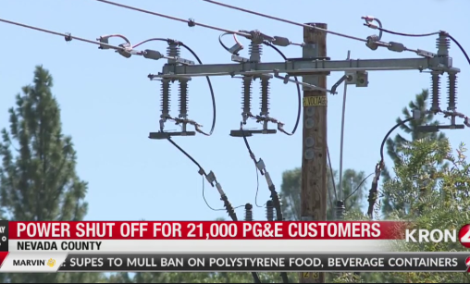
PSPS and Outages:
Who is most vulnerable?
  Isolated individuals: may have limited communication tools
  Children and older adults: who depend on care facilities
  People with disabilities or medical conditions: who depend on equipment that requires electricity
  Low-income individuals: may experience food insecurity due to food spoilage and may lose wages due to businesses being closed
  Overlapping vulnerabilities: to heat and other hazards
  Homes and businesses with powerlines in elevated or extreme wildfire risk areas
  (During storms) people with powered sump pumps often in basements
Notes:
So who is the most vulnerable during power outages and shutoffs
When there is a power outage, lighting and communication methods such as cell phones may lose power,
So people who live in isolated areas may have limited communication tools
Children or elders in care facilities and their caregivers may have to change their routines if the facilities must close
People with disabilities or medical conditions who depend on electric medical and mobility devices
There’s a risk for food spoilage because power outages could last for 24-72 hours or longer
So Low-income individuals may be impacted if food needs to be thrown away
Additionally wages may be lost due to businesses being closed
People with overlapping vulnerabilities may be further impacted by power shutoffs
For example, people vulnerable to extreme heat may not be able to use AC to cool down in the event of a power shutoff
Homes and businesses with powerlines in the elevated or extreme wildfire risk areas are more likely to have their power shut off to prevent fire risk
And during storms, people may be affected if they have a powered pump removing rain or flood water from their homes

Slide 37
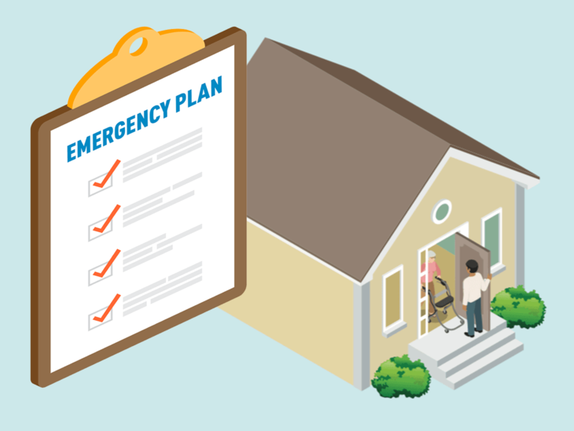
Existing Program Support for Households
Medical Baseline Program
  Extra PG&E notifications in advance of PSPS events
  PG&E Portable Battery Program for income qualified participants
Disability Disaster Access & Resources Program
  Portable backup batteries, hotel accommodations, accessible transportation, food vouchers
  Community Resources for Independent Living (CRIL) in Hayward, CA – 510-881-5743
  Center for Independent Living (CIL) in Berkeley, CA – 510-841-4776
Reference: PG&E
Notes:
There are some support programs to aid people during power outage events
The main program from PG&E is the Medical Baseline program. It is for any person with an eligible medical condition or a medical device that uses power. Once you enroll in the program, this allows you to get a bill reduction for the use of electricity for life saving devices, as well as extra PG&E notifications – they will call you or even come to your door to make sure that you know about planned shutoffs.
PG&E also has a Portable Battery program which allows you to get a fully subsidized battery for use during these events.
Additionally, There is a Disability Disaster Access & Resources Program that is run by Independent Living Centers, serving people with disabilities. They provide support that includes portable backup batteries, hotel accommodation, and food vouchers.
CRIL serves southern and eastern Alameda County, and CIL serves Northern Alameda County including Berkley, Oakland, Alameda, Emeryville, Piedmont, and Albany

Slide 38
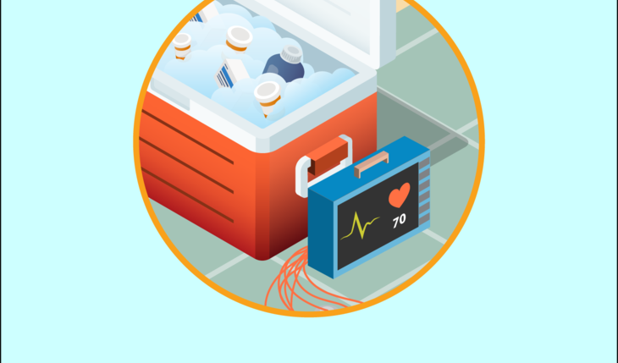
Gaps in Support
Support for people not on medical baseline, but require refrigerated medication (i.e. insulin) or other equipment
Medical baseline has a high access barrier with documentation and may be difficult to get on for people with low English skills even if they qualify
Notes:
However, there are some populations to be aware of that may not be served by current program offerings.
For example, people with refrigerated medication will be affected, but are not served by the Medical Baseline program.
Medical Baseline requires documentation from a doctor, which may take several steps to obtain, and require language skills.
The portal is also only available to government agencies, not community health providers.

Slide 39
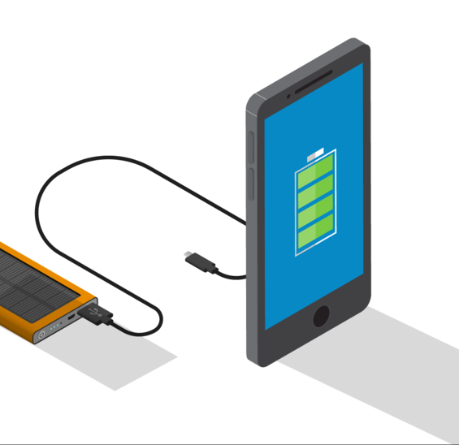
PSPS and Outages:
How to prepare and stay safe
Fill medications early
Stock up on non-perishable food
Make your own ice to cool food and limit opening the fridge once power is off
Find “buddies” for those living alone
Call 2-1-1 or the Non-Emergency Power Shutoffs Hotline at 833-284-3473 for help
Have backup keys for electronic keys and locks
During shutoff, unplug large electrical appliances that may surge when power returns
Keep flashlights and solar/battery lanterns on hand
Reference: PG&E
Notes:
So how can you prepare and stay safe?
(read slide)

Slide 40
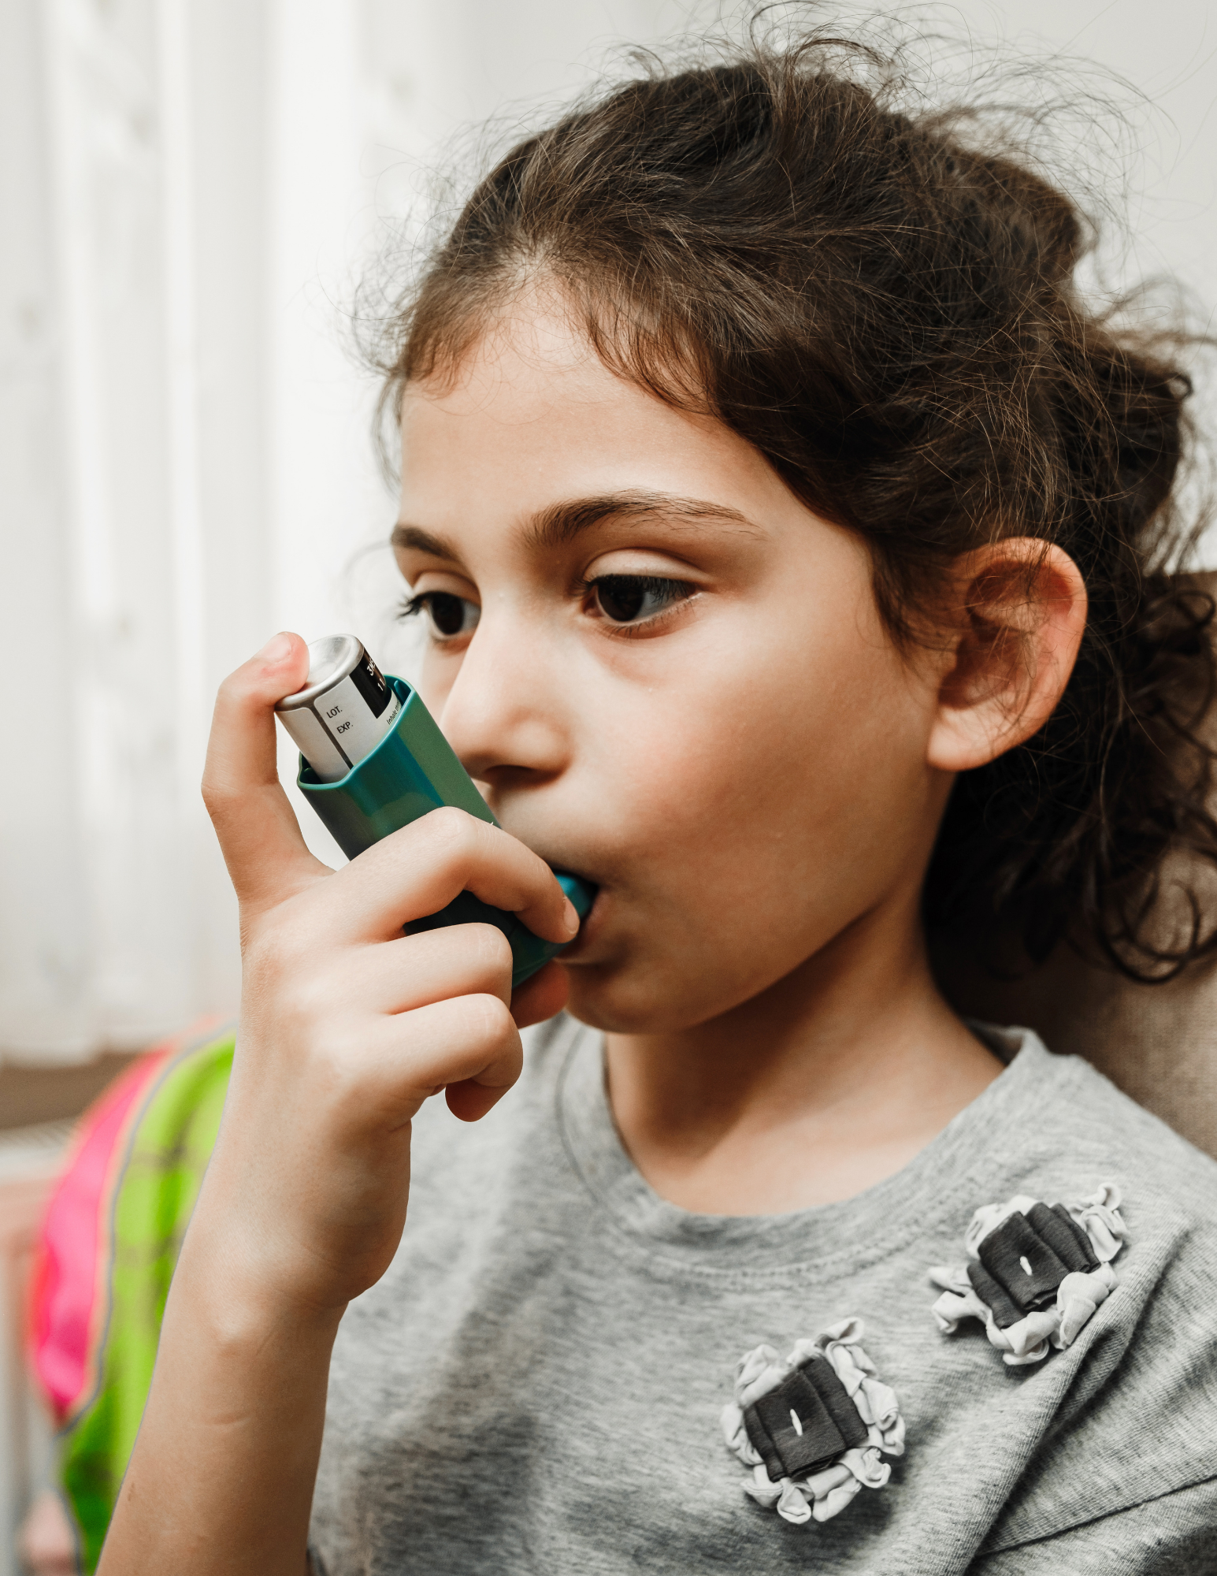
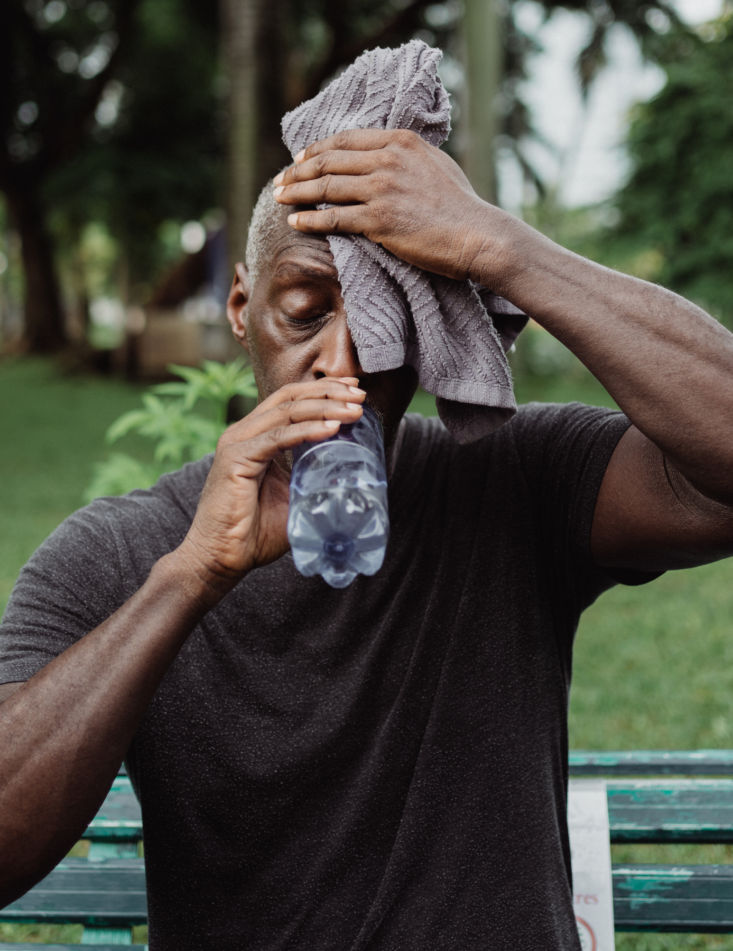
How can we support you in becoming more resilient to climate hazards?
What do you need before, during, and after climate events?
How do you want to receive info?
What kinds of trainings do you want, and where?
What questions do you have?
Young girl using an inhaler
Older man sweating from heat and drinking water
Notes:
This concludes our presentation
Now, we’d like to open a conversation – how can we support you in becoming more resilient to climate hazards?
Raise your hand if you have a response – we want to hear what you need to support those in your community, how you can receive information, and how can we encourage these protective actions in the community.
(discuss)
Thank you, we will learn from what you shared today

Slide 41

What questions do you have?

Slide 42
Thank you
For helping us build a more resilient community!
Bay bridge in the background of a man with mask on and orange skies
Sign on door that reads “store closed, no electricity, will open as soon as possible”
Sign outside of a building announcing “cooling center”
Notes:
Thank you for attending our training, and for everything you do to help make our community healthier and more resilient
{Please stay in touch [share contact information on slide or verbally]}

Slide 43

Resources
Photo by Nick Fewings on Unsplash: Assorted-title book lot placed on white wooden shelf photo – Free Reading Image on Unsplash
Notes:
The next couple of slides include lists of links that may be useful to you.
We encourage you to sign up for the best alert system for you, in your county and your city if applicable.
You can see here multilingual resources to help you and your communities prepare.

Slide 44
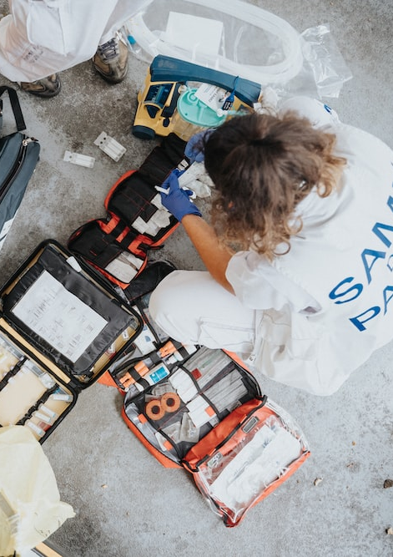
Preparedness Resources
Sign up for AC Alert: AC Alert - Public - Sign In (everbridge.net)
  ACAlertSignUpFebruary19MobileApp.pdf (acgov.org)
Emergency Preparedness - Alameda County (acgov.org)
  Plan Ahead for Disasters | Ready.gov
Prepare Your Family Before, During and After a Disaster | Cal OES News
Emergencies | Alameda County (acgov.org)
Listos California
genasys Protect
  Zone Status and Color Meanings (genasys.com)
Photo by Mat Napa on Unsplash: Boy in white shirt sitting on orange and black backpack photo – Free Medical infusion Image on Unsplash
Notes:
here are links to resources for preparedness and evacuation

Slide 45
Heat Wave Resources
Alameda County Public Health on Heat and Health (multilingual)
Cooling Centers: https://www.acgov.org/emergencysite/
Notes:
Here are links to heat wave resources

Slide 46
Wildfire & Smoke Resources
AirNow fire and smoke map
Alameda County Wildfire Smoke, COVID, and Health FAQ (multilingual)
CDPH Wildfire Smoke FAQ
EPA guidance on clean air during wildfire
Alameda County Local Hazard Mitigation Plan (acgov.org)
California Department of Forestry and Fire Protection | CAL FIRE
Home - Ready for Wildfire
Defensible Space Flyer
Clean Air Centers: https://www.acgov.org/emergencysite/
Notes:
here are links to resources for air quality information, and how to stay protected from smoke.

Slide 47
PSPS Resources
PG&E real-time PSPS Updates
PSPS alert sign up from PG&E
Power outage alerts and information (pge.com)
PG&E Prepare for PSPS
PG&E Medical Baseline Program
PG&E Vulnerable Customer Program
Disability Disaster Access & Resources Program
PG&E PSPS support resources, including translated outreach material
PG&E Community Resource Centers
California Health and Human Services PSPS Resource Guide
California Public Utilities Commission Fire-Threat Map
Notes:
PG&E provides several resources for planned power shutoffs – see those at these links.

