Slide 1



Where Value meets Values®
Welcome!!
Cities, schools and agencies of Alameda County
An Introduction to Give Something Back Office Supplies.
Sean Marx (L) and Mike Hannigan (R), co-founders and owners since 1991.
Giving is at the heart of our business.

Slide 2

Meet Our Founders…
Yep, those are our owners Sean Marx and Mike Hannigan. They created the company in 1991 on the premise that we don’t need to give dividends to stockholders, we can donate the profits to nonprofits instead! But they realized that they had to offer competitive prices and superior service to make it work. At GSB you’re signing up for more that supplies. It’s easy to get what you need while helping those in need.

Slide 3

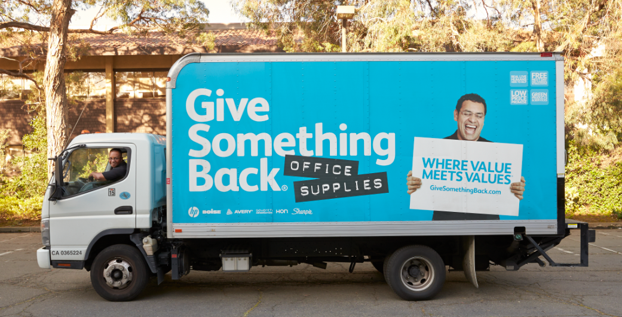
Our Customer Commitment…
We don’t want just anyone delivering your order, we want someone you can get to know and trust. That’s why we have our own delivery team.

Slide 4
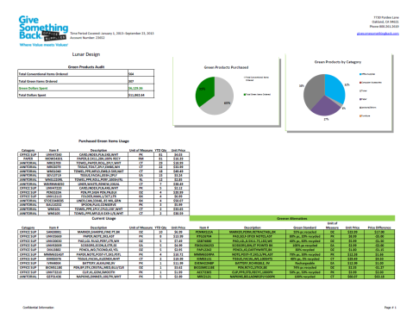
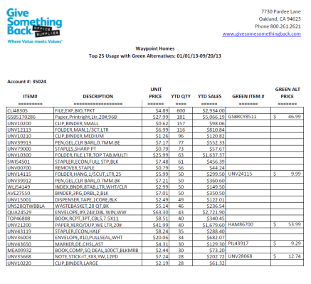
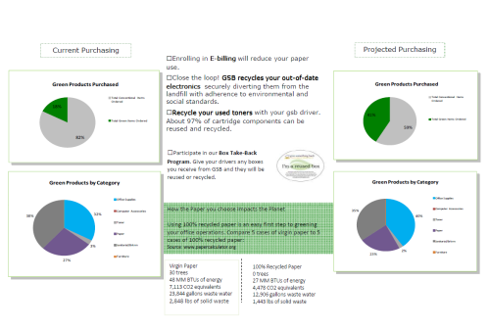
Trying to go greener?
Consider us your partner in a green(er) office
We’ve been rocking the green thing from the very beginning. It’s our core, not a bandwagon. We are proud to offer more than 6,000 affordable recycled and green options in almost every product category. At GSB it goes beyond just products, it’s about doing all we can to create healthy communities.
Green Reporting
You don’t have to wear a cape to save the planet. In fact, just by buying greener products for your company, you could dramatically make your company a more earth-friendly place! Don’t know where to start? The Green Audit is a great way to evaluate your current green purchases, and can provide a stepping stone for you to move in the green direction.

Slide 5
You’ll have a dedicated
GSB Team…
With a team member on the outside, inside and behind the wheel, we partner with you to simplify the purchasing process.
We promise to make buying office supplies easy, to provide an unmatched customer experience, to offer competitive pricing, and to give our profits back to the community.
If we are not delivering on that promise at any time, we promise to make it right.
Community Cultivator aka. Senior Account Manager - Public Sector
Louis Schuster Mobile: 510-292-9633
Customer Concierge aka. Inside Account Manager:
Jerred Hurst Office: 510-635-5500 Ext. 2015
Load & Spirit Lifter aka. Delivery Driver:
John Armstrong
Fun & Fund Raiser aka. Accounts Receivable
Verna Carter Office: 510-635-5500 Ext. 2321
We are offering Alameda County contract #900962 9934 to all
Public agencies in Alameda County. As the paper provider to many of Northern California’s largest public institutions for going on two decades, we’re thrilled to be able to provide high quality Boise & Georgia Pacific recycled paper at some of the best pricing we’ve ever seen! Call or email Louis to get started.

Slide 6
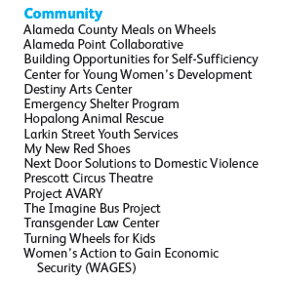
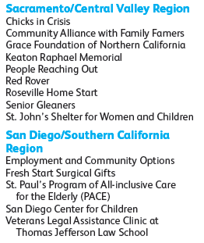
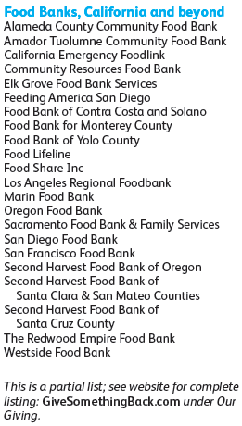

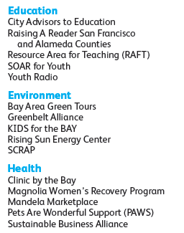

Using the power of business to support community needs...
Our 2012 Grant Recipients

